Slide 1





PROFESSIONAL DEVELOPMENT COURSE
EDUCULTURE EXCHANGE PROGRAMME 2025
MODULE 12
COMMUNICATION AND PRESENTATION SKILLS
DR. AZMAN BIN BIDIN
Bridging Cultures, Inspiring Minds
UMK-ITBM TRANSLATION & MANUSCRIPT CENTRE I TERMEZ STATE PEDAGOGICAL INSTITUTE

Slide 2

COMMUNICATIONS AND PRESENTATIONS SKILLS
Key elements of effective communication.
Strategies for delivering an impactful presentation
Engaging audiences by integrating technology.
Practical exercise in academic and professional communication.
UMK-ITBM TRANSLATION & MANUSCRIPT CENTRE I TERMEZ STATE PEDAGOGICAL INSTITUTE
ONLINE I UMK CONEZION PUTRAJAYA MALAYSIA

Slide 3
LEARNING OBJECTIVES
  Understand key communication elements by learning clarity, listening, tone, and body language for effective interactions.
  Deliver confident, clear presentations by practising structured content, voice, and body language to enhance skills.
UMK-ITBM TRANSLATION & MANUSCRIPT CENTRE I TERMEZ STATE PEDAGOGICAL INSTITUTE
ONLINE I UMK CONEZION PUTRAJAYA MALAYSIA

Slide 4
LEARNING OBJECTIVES
  Use technology to engage the audience by incorporating digital tools and multimedia to make communication dynamic.
  Practise academic and professional communication by applying skills in writing, discussions, and presentations in real-world contexts.
UMK-ITBM TRANSLATION & MANUSCRIPT CENTRE I TERMEZ STATE PEDAGOGICAL INSTITUTE
ONLINE I UMK CONEZION PUTRAJAYA MALAYSIA

Slide 5
KEY ELEMENTS OF
EFFECTIVE COMMUNICATION
UMK-ITBM TRANSLATION & MANUSCRIPT CENTRE I TERMEZ STATE PEDAGOGICAL INSTITUTE
ONLINE I UMK CONEZION PUTRAJAYA MALAYSIA

Slide 6
Effective communication is the foundation of strong relationships and successful collaborations. It involves the intentional exchange of messages between two or more people, guided by essential components.
UMK-ITBM TRANSLATION & MANUSCRIPT CENTRE I TERMEZ STATE PEDAGOGICAL INSTITUTE
ONLINE I UMK CONEZION PUTRAJAYA MALAYSIA

Slide 7
Basic elements of communication
Sender - The person who starts the communication. They have an idea or message and turn it into words or signals (encoding) that others can understand.
Receiver - The person who gets the message. They read, hear, or see it, and then try to understand its meaning (decoding).

Slide 8
Basic elements of communication
Message - This is the actual information the sender wants to share. It can include extra meaning through tone of voice or body language.
Medium - The way the message is sent. This could be a phone call, text message, face-to-face chat, email, or even TV/radio.
Feedback - The receiver’s response. It shows if the message was understood. Feedback can be direct (words) or indirect (actions)

Slide 9
Basic elements of communication
Noise - Interference (physical, psychological, or semantic) that disrupts or distorts the message during communication — like a bad signal, cultural differences, or unclear words.
Context - The situation or setting. The environment and circumstances ( in private or in public place). The factors (physical setting, cultural background, social dynamics, and the relationship between communicators)

Slide 10
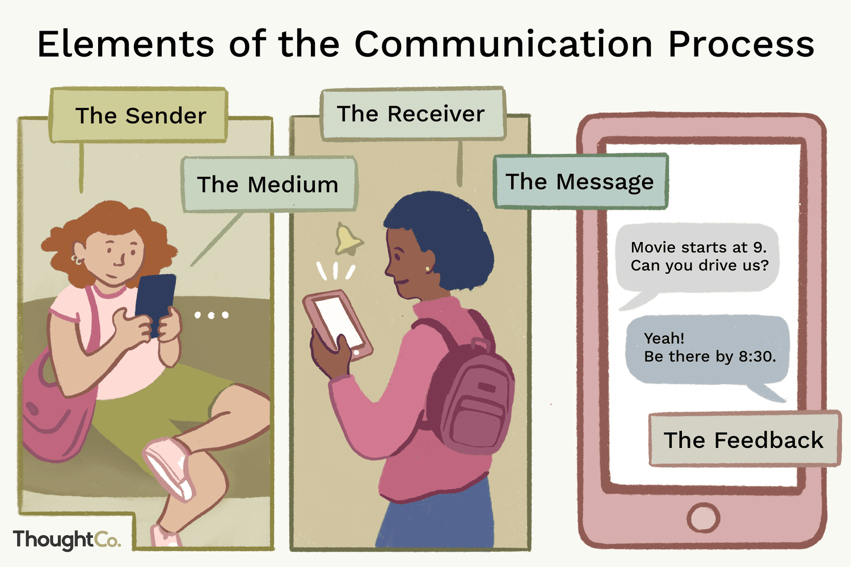
Basic elements of communication
https://www.thoughtco.com/what-is-communication-process-1689767

Slide 11
Key elements of effective communication
Enhancing communication skills reduce misunderstandings and promote better
interactions. Individuals and organisations can improve communication practices
with effective communication skills (Evolution Recruitment Solutions, 2021).
Empathy - Understanding others' feelings before speaking helps deliver messages thoughtfully and find common ground during disagreements. Empathy in communication, which involves understanding the emotions or perspectives of others, aligns with the
respect for cultural values that both the interviewers demonstrated during the interaction
in Awang, Maros, & Ibrahim (2012) research.

Slide 12
Key elements of effective communication
Listening - Active listening encourages open communication and builds trust. It involves fully concentrating, understanding, responding to, and remembering what is being said. Creating an environment where individuals feel heard promotes openness and trust.
Clarity - Clear and simple messages reduce confusion and improve understanding. From Awang et al. (2012) study, Malay values (indirectness and politeness) can sometimes clash with the need for clarity. Hence, it is important to present the message concisely to ensure it is easily understood.

Slide 13
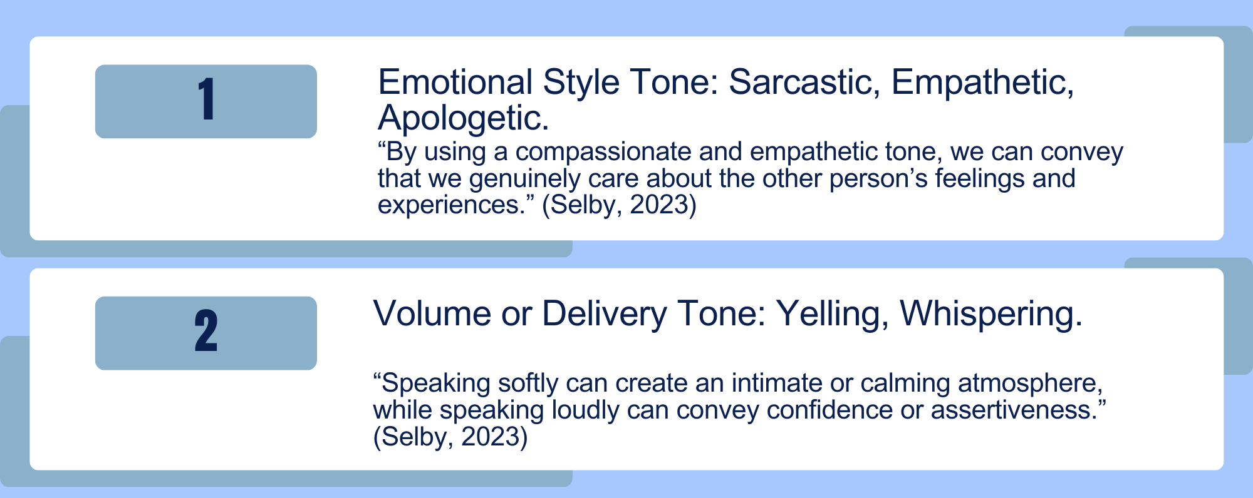
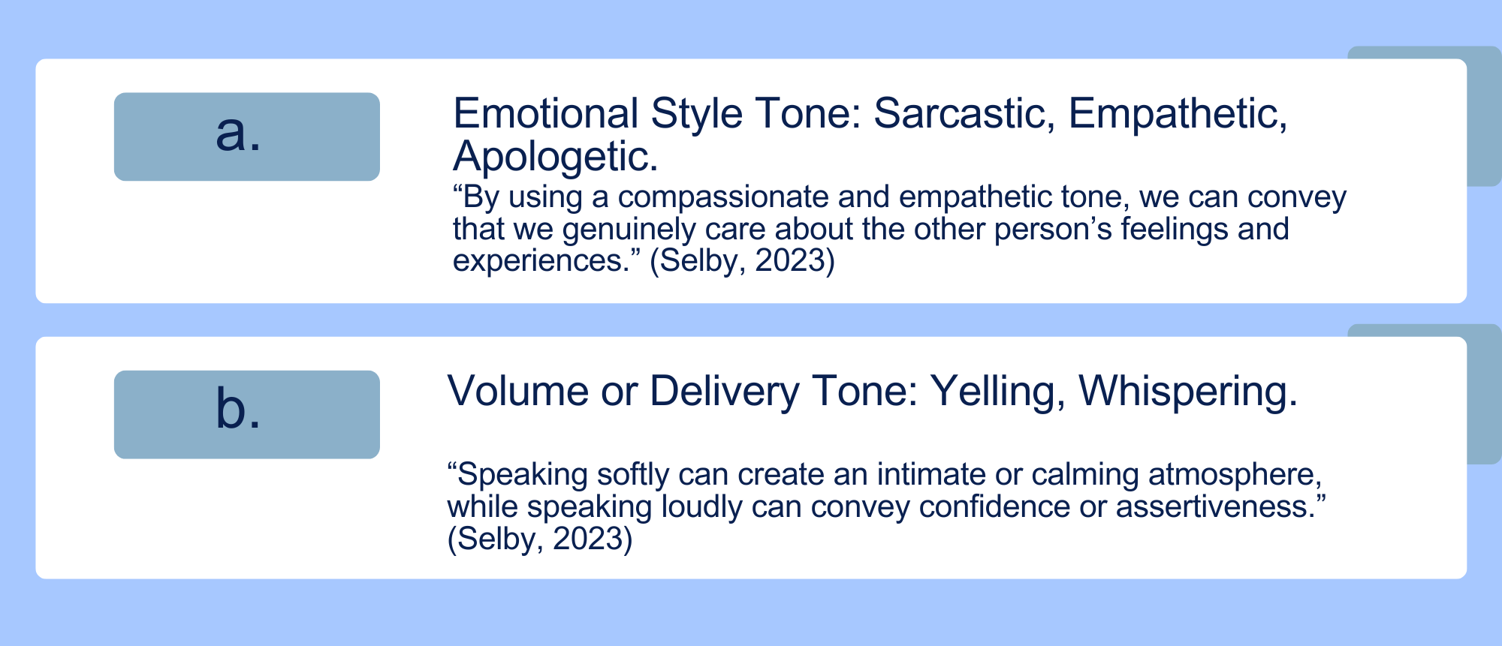
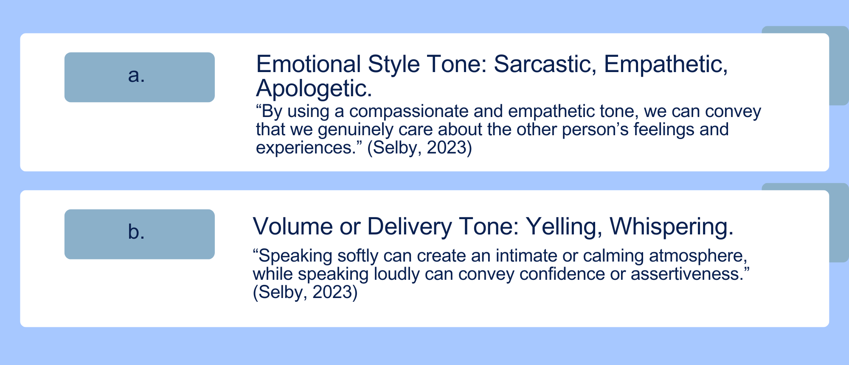
Key elements of effective communication
Non-verbal communication - Plays a critical role as Malay values of humility
and politeness are often communicated through tone, gestures, and facial expressions.

Slide 14
Key elements of effective communication
Be personable - Friendly interaction with colleagues promotes a positive and respectful environment.
Respect - Using polite language, staying focused, and active listening show respect and professionalism.
Medium - Choosing the right communication method (email, call, face-to-face) enhances message effectiveness and avoids misunderstandings

Slide 15
Oxford English Dictionary (OED)
Officially included 12 new words that are commonly used in Malaysia, also known as "Manglish." These words reflect the unique culture, language, and everyday experiences of the people in the country.
Highlights how language evolves by incorporating regional expressions and cultural influences, which is crucial for effective communication across diverse cultures.

Slide 16


Oxford English Dictionary (OED)
"Alamak": An expression of surprise or dismay. Alamak is often
a substitute of “OMG”, “oh no” and it can be an expression for a
state of shock, disappointment or disapproval.
"Nasi lemak": A popular Malaysian dish made with rice
cooked in coconut milk.
"Tapau": A term for taking away food, common in local food culture.
b.
c.

Slide 17
STRATEGIES FOR DELIVERING IMPACTFUL PRESENTATIONS
UMK-ITBM TRANSLATION & MANUSCRIPT CENTRE I TERMEZ STATE PEDAGOGICAL INSTITUTE
ONLINE I UMK CONEZION PUTRAJAYA MALAYSIA

Slide 18
Strategies for delivering impactful presentations
1. Plan
Define the purpose and desired outcomes of the presentation.​
Analyse the audience's background, expectations, and needs.​
Develop relevant and concise material.
Plan the delivery style (tone, pace, and body language)

Slide 19
Strategies for delivering impactful presentations
2. Prepare
Use clear headlines, concise content, and supportive visuals.​
Maintain a consistent design and format throughout.​
Ensure all materials directly support the presentation's objectives.

Slide 20
Strategies for delivering impactful presentations
3. Practice
Practice the presentation multiple times to ensure smooth delivery.
Seek feedback from peers to identify areas for improvement.​

Slide 21
Strategies for delivering impactful presentations
4. Present
Connect with the audience through eye contact and interaction.​
Speak clearly and at an appropriate pace.​
Demonstrate confidence through posture and tone.​

Slide 22
Aristotle's rhetorical appeals
Public speaking is more than just sharing information; it's about persuading, inspiring, and connecting with audiences. Aristotle, the ancient Greek philosopher, identified three core rhetorical appeals - ethos, pathos, and logos that remain fundamental to effective communication today.​ (Yoodli, 2023)

Slide 23
Aristotle's rhetorical appeals
1. Ethos (Credibility)
  Establish trust.
  Cite reliable sources.
  Project confidence.
  Emphasise ethical conduct.

Slide 24
Aristotle's rhetorical appeals
2. Pathos (Emotional connection)
  Understand the audience.
  Use storytelling.
  Evoke appropriate emotions.
  Empathise with the audience.

Slide 25
Aristotle's rhetorical appeals
3. Logos (Logical reasoning)
  Present clear and concise arguments.
  Use strong evidence.
  Address counterarguments.
  Use visual aids.

Slide 26
ENGAGING AUDIENCES
BY INTEGRATING TECHNOLOGY
UMK-ITBM TRANSLATION & MANUSCRIPT CENTRE I TERMEZ STATE PEDAGOGICAL INSTITUTE
ONLINE I UMK CONEZION PUTRAJAYA MALAYSIA

Slide 27
Incorporating interactive platforms
(such as presentation tools or multimedia resources) could further enhance understanding by providing
more context and bridging cultural gaps visually,
through audio-visual cues.
UMK-ITBM TRANSLATION & MANUSCRIPT CENTRE I TERMEZ STATE PEDAGOGICAL INSTITUTE
ONLINE I UMK CONEZION PUTRAJAYA MALAYSIA

Slide 28
Engaging audiences by integrating technology
According to The Collective (2024), engaging remote audiences requires adapting communication styles to digital formats. In today's digital age, integrating technology into presentations is essential for capturing and maintaining audience attention. Utilising interactive tools and platforms can transform passive listeners into active participants, thereby enhancing the overall effectiveness of the presentation.

Slide 29
Interactive Presentation Tools
Kahoot!: A game-based learning platform that allows presenters to create quizzes, polls, and interactive slides, fostering real-time engagement and feedback.
Padlet: An online bulletin board where participants can post responses, ideas, and feedback, facilitating collaborative learning and discussion.​

Slide 30
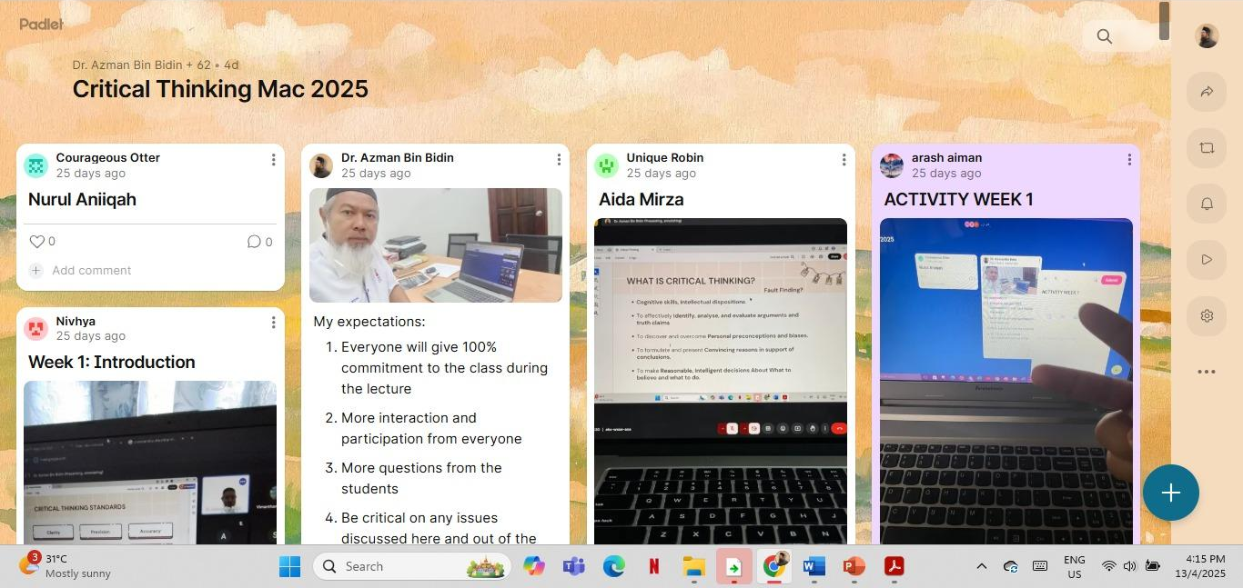
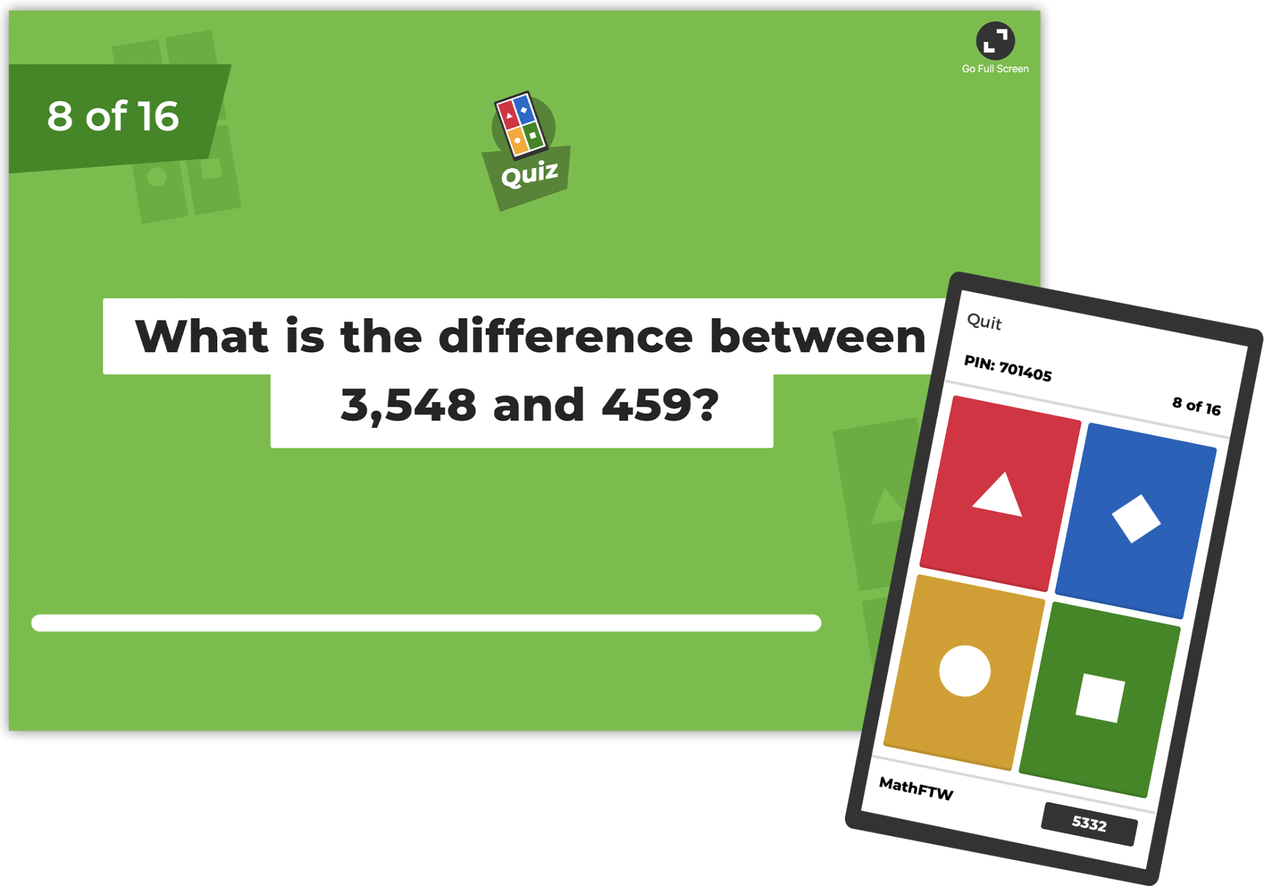
Interactive Presentation Tools

Slide 31
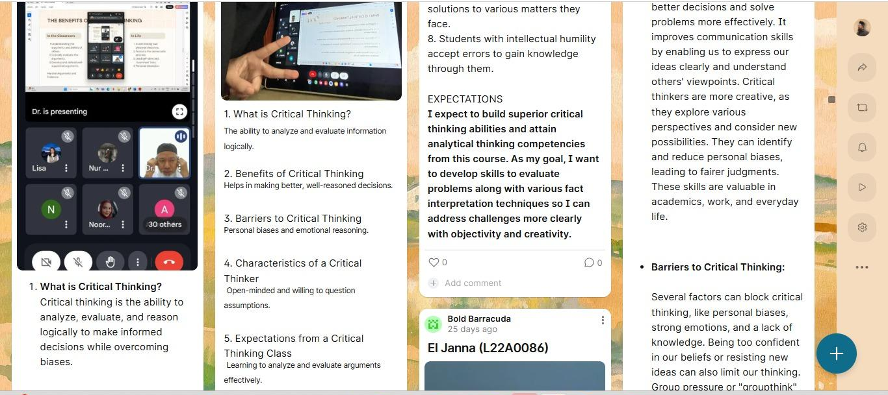

Slide 32
Interactive Presentation Tools
https://kahoot.com/files/2019/10/Schools-How-it-works-HostLive-Screenshot.png

Slide 33
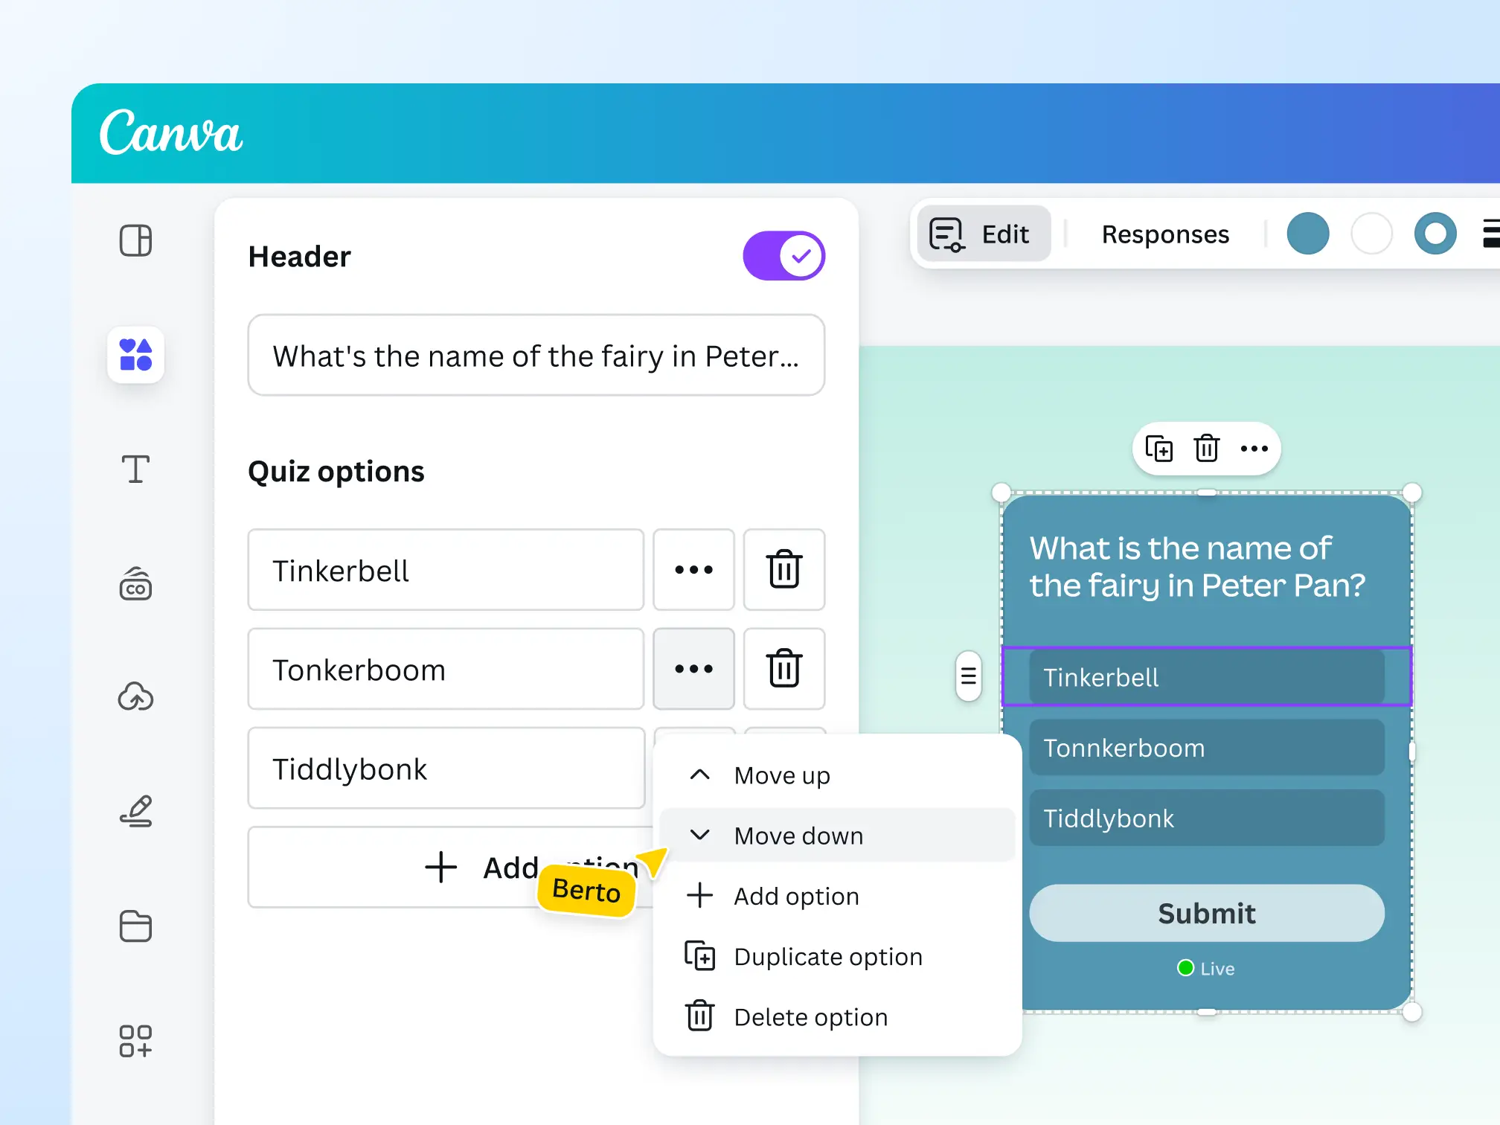
Interactive Presentation Tools
https://www.canva.com/quiz-maker/

Slide 34

AI-Powered Personalisation
ChatGPT can generate personalized messages. A study in Scientific Reports shows that ChatGPT-created personalized messages
are significantly more effective than
non-personalized ones. (Matz et al., 2024)
ChatGPT can organize and generate text suitable
for slides and suggest visual elements.

Slide 35

AI-Powered Personalisation
DeepSeek also can create personalized messages that would increase engagement.
Helps deliver content that’s more meaningful
and aligned with what users truly need.
It generates clear, structured text from raw data and
can include matching visuals like charts and graphs.

Slide 36
Hybrid Engagement Tools
Google Meet: A video conferencing platform that supports real-time collaboration through features like screen sharing, chat, and breakout rooms, enabling interactive sessions for both in-person and remote participants.​
Zoom: Offers similar functionalities with additional features such as virtual backgrounds and polling, providing a versatile environment for hybrid presentations.

Slide 37
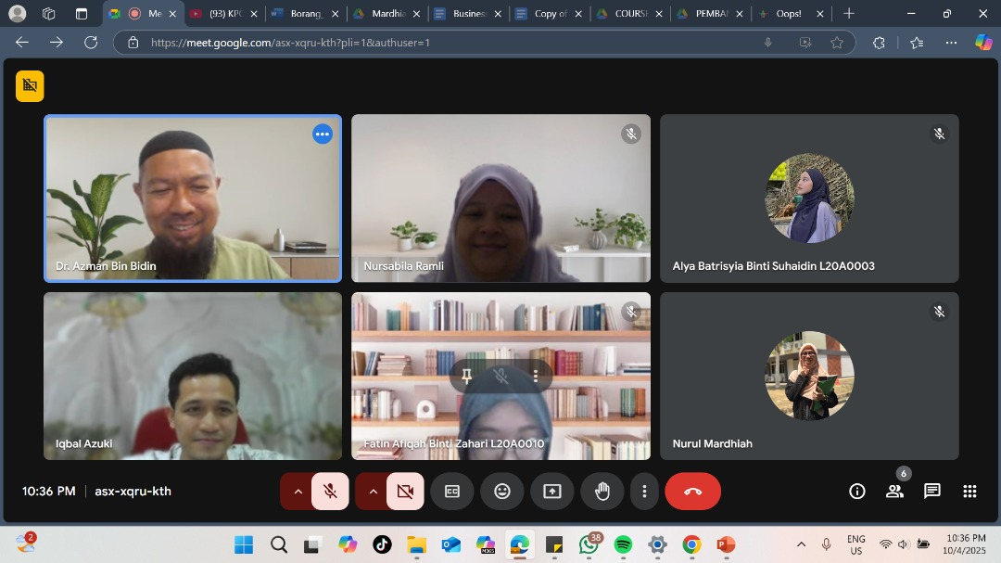
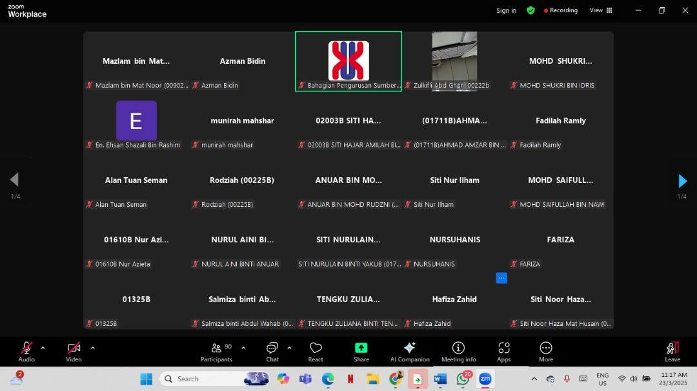
Hybrid Engagement Tools

Slide 38
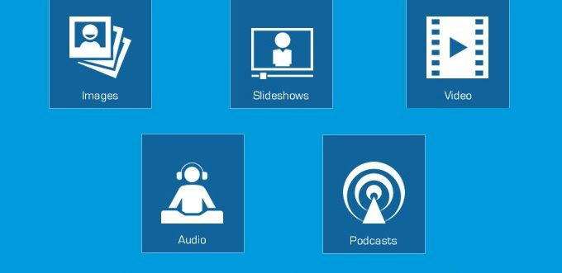
Multimedia Integration (Videos,
Animations, Infographics)
https://www.newperspectivestudio.co.za/wp-content/uploads/2023/10/Importance-of-MultiMedia-Content-680x331-1.jpg

Slide 39
PRACTICAL EXERCISES IN ACADEMIC AND
PROFESSIONAL COMMUNICATION
UMK-ITBM TRANSLATION & MANUSCRIPT CENTRE I TERMEZ STATE PEDAGOGICAL INSTITUTE
ONLINE I UMK CONEZION PUTRAJAYA MALAYSIA

Slide 40
DRAB Technique
Active listening and effective communication.
  Demonstrate interest - Show genuine attentiveness.
Maintain eye contact.
Nod and use verbal responses during discussions.
Builds supportive and attentive communication environment.

Slide 41
DRAB Technique
Respect for the speaker - Listen without interruption or judgement.
Don’t interrupt.
Acknowledge their perspective and avoid judgement.
Fosters empathetic listening and inclusive conversations.

Slide 42
DRAB Technique
Ask clarifying questions - Ensure clear understanding and engagement.
Ask to understand better.
Show genuine interest in their message.

Slide 43
DRAB Technique
Bridge understanding gaps - Relate and summarise
for clarity.
Paraphrase or summarise what was said.
Link to your own experience.
Confirms comprehension and shows emotional validation.

Slide 44
End of Module Practice
1. Questions
UMK-ITBM TRANSLATION & MANUSCRIPT CENTRE I TERMEZ STATE PEDAGOGICAL INSTITUTE
ONLINE I UMK CONEZION PUTRAJAYA MALAYSIA

Slide 45
Additional Notes

Slide 46
The End
UMK-ITBM TRANSLATION & MANUSCRIPT CENTRE I TERMEZ STATE PEDAGOGICAL INSTITUTE
ONLINE I UMK CONEZION PUTRAJAYA MALAYSIA

Slide 47
References
Awang, S., Maros, M., & Ibrahim, N. (2012). Malay values in intercultural communication. International Journal of Social Science and Humanity, 2(3), 201–205. https://doi.org/10.7763/IJSSH.2012.V2.96
Evolution Recruitment Solutions. (2021, July 29). 7 key elements of effective communication. Retrieved from https://evolutionjobs.com/exchange/7-key-elements-of-effective-communication/
Flevy. (2024, June 27). 4 Ps of effective presentations. Retrieved from https://flevy.com/blog/4-ps-of-effective-presentations/
INFORMS. (n.d.). The science of effective presentations: Using Monroe’s motivated sequence to communicate analytical findings. Retrieved from https://pubsonline.informs.org/do/10.1287/orms.2024.04.04/full/

Slide 48
References
Nulab. (n.d.). Mastering Monroe’s motivated sequence: A guide to persuasive speaking. Retrieved from https://nulab.com/learn/collaboration/monroes-motivated-sequence/
Nordquist, R. (2024, June 4). The basic elements of the communication process. ThoughtCo. Retrieved from https://www.thoughtco.com/what-is-communication-process-1689767
Selby. (2023, August 21). Tone of voice: a crucial element in effective communication explained. Everyday Speech. https://everydayspeech.com/sel-implementation/tone-of-voice-a-crucial-element-in-effective-communication-explained/

Slide 49
References
South China Morning Post. (2025, March 27). 12 words in Malaysia, Singapore-style English enter Oxford dictionary. Retrieved from https://www.scmp.com/week-asia/lifestyle-culture/article/3304135/12-words-malaysia-singapore-style-english-enter-oxford-dictionary
University of Louisville – College of Business. (n.d.). Unify and present: Using Monroe’s motivated sequence to teach team presentation skills. Retrieved from https://business.louisville.edu/faculty-research/research-publications/unify-and-present-using-monroes-motivated-sequence-to-teach-team-presentation-skills/

Slide 50
References
Yoodli. (2023, June 7). The power of ethos, pathos, and logos in public speaking. Retrieved from https://yoodli.ai/blog/the-power-of-ethos-pathos-and-logos-in-public-speaking

