Slide 1
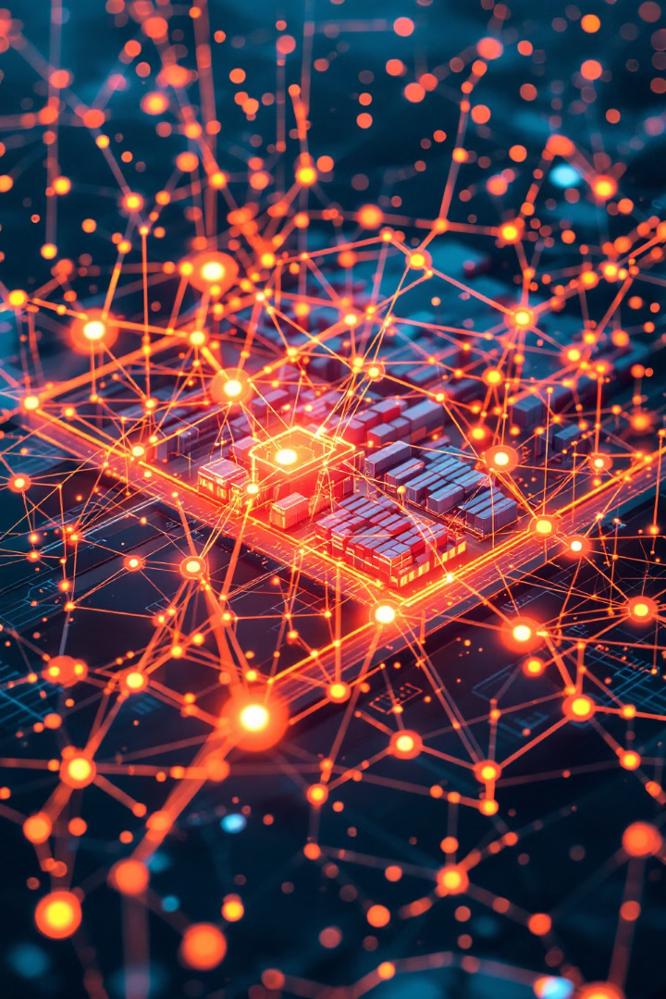
IoT in Logistics: Revolutionizing the Supply Chain
A comprehensive introduction to the transformative power of IoT in modern logistics, exploring its definition, importance, key components, and real-world applications.
by Zailani bin Abdullah, Ph.D
WW

Slide 2




What is the Internet of Things (IoT)? A Simple Explanation
Sensors
Connectivity
Data Processing
Devices that detect and measure physical quantities.
Enables communication between devices and the cloud.
Transforms raw data into actionable insights.

Slide 3
Defining IoT in Logistics: Connecting the Physical and Digital Worlds
Physical World
Digital World
Connection
Goods, vehicles, warehouses, and infrastructure.
Data, analytics, and software platforms.
Bridging the gap for real-time visibility and control.

Slide 4
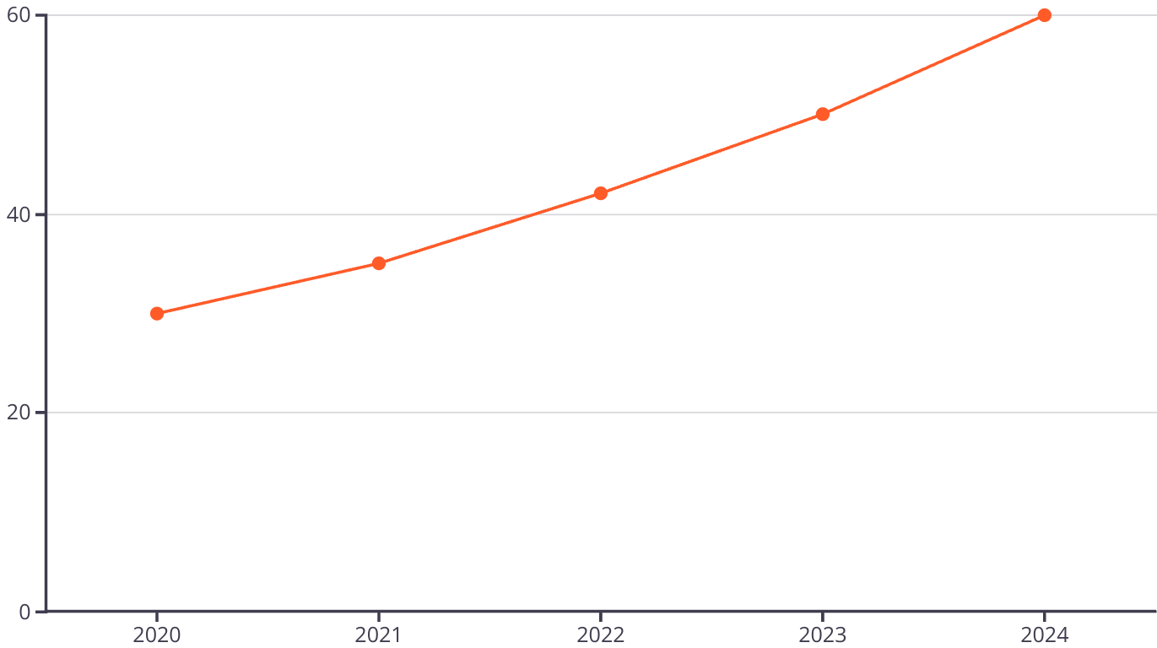
The Explosive Growth of IoT Devices: A Visual Representation

Slide 5
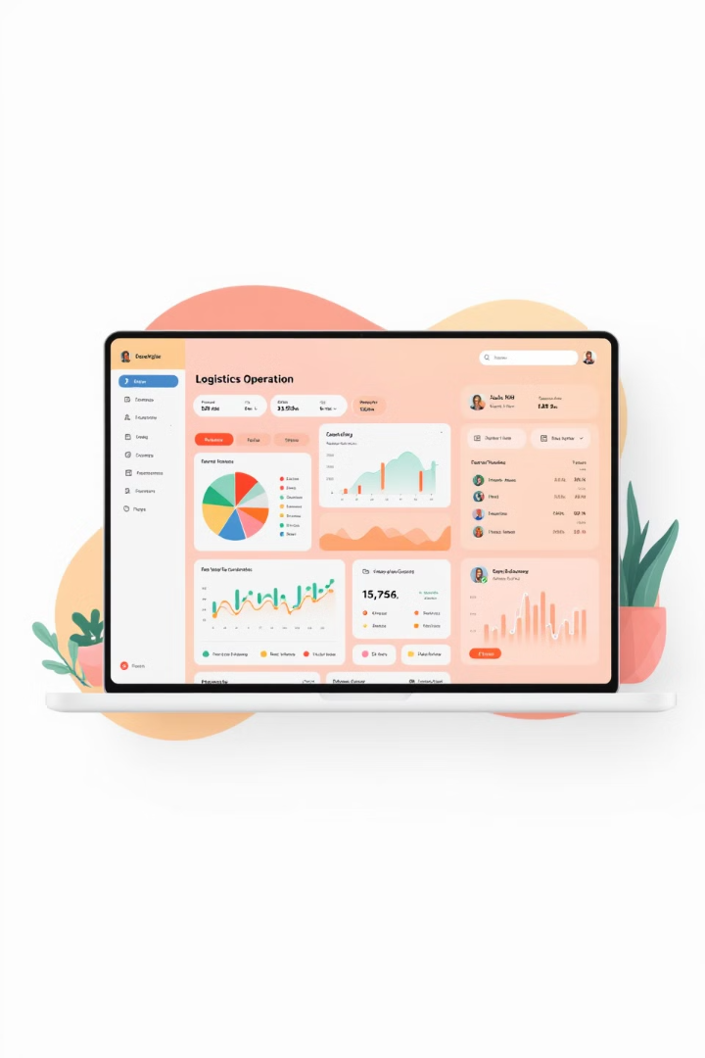
Why is IoT Crucial for Modern Logistics?
1
Real-Time Visibility
Track goods and assets.
2
Data-Driven Insights
Optimize operations with analytics.
3
Automation
Streamline processes.
4
Improved Efficiency
Reduce costs and delivery times.

Slide 6
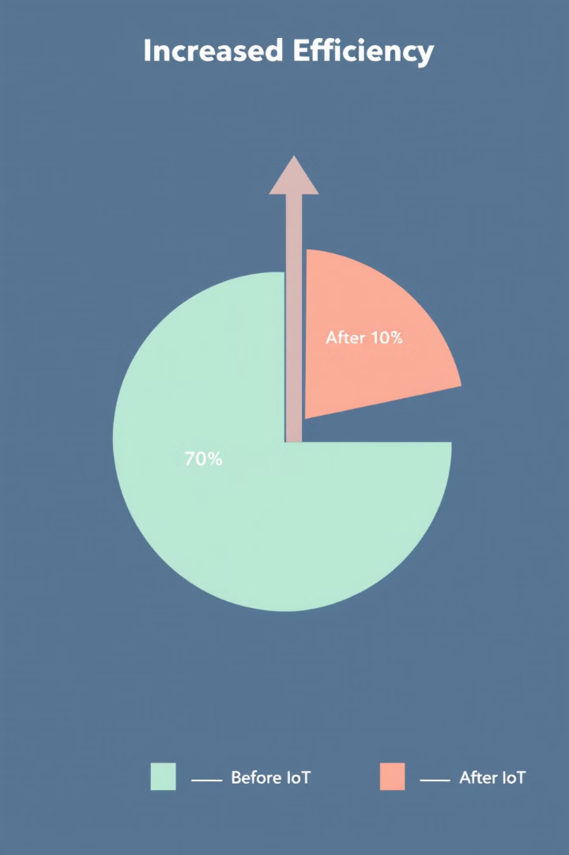




Increased Efficiency and Reduced Costs: Data-Driven Optimization
Data Collection
Gather real-time info from sensors and devices.
Data Analysis
Identify bottlenecks and inefficiencies.
Optimization
Adjust processes based on insights.
Cost Reduction
Minimize waste and improve resource utilization.

Slide 7

Enhanced Visibility and Tracking: Real-Time Location Monitoring
1
Origin
Track goods from the source.
2
Transit
Monitor location during transportation.
3
Warehouse
Manage inventory within facilities.
4
Delivery
Ensure timely arrival to the customer.

Slide 8
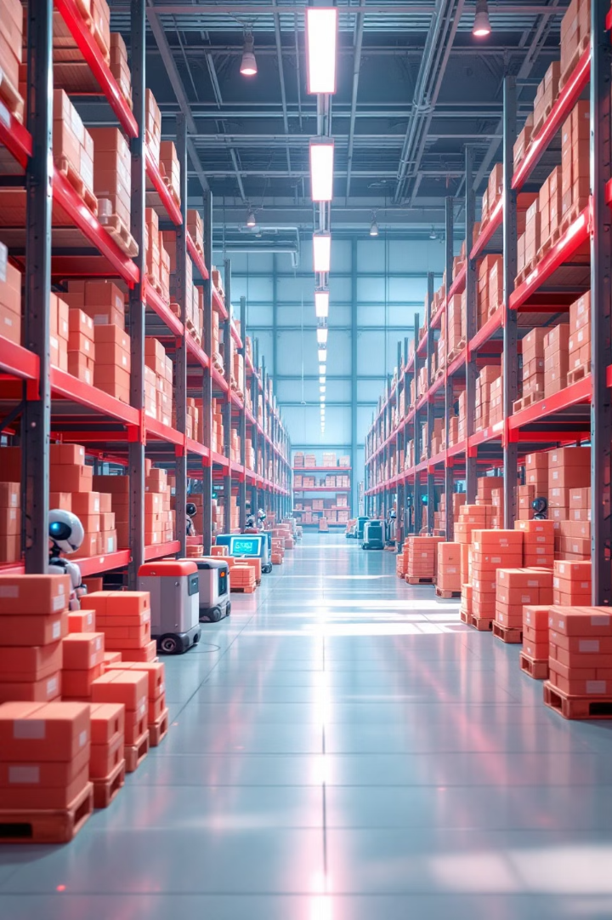
Improved Inventory Management: Smart Warehouse Solutions
Automated Tracking
Real-time inventory updates.
Optimized Storage
Efficient space utilization.
Reduced Errors
Accurate stock levels.
Demand Forecasting
Predictive analytics for inventory planning.

Slide 9




Predictive Maintenance and Reduced Downtime: Keeping Operations Smooth
Sensor Monitoring
1
Data Analysis
2
4
Preventive Action
3
Predictive Alerts

Slide 10




Key Components of an IoT Logistics System: An Overview
Software
1
Data management and analytics
Data Processing
2
Actionable Insights
Connectivity
3
Device Communication
Sensors
4
Data Gathering

Slide 11

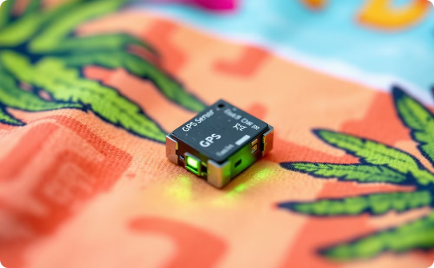

Sensors: Gathering Data from the Physical World
Temperature
Location
Humidity
Monitor temperature-sensitive goods.
Track location in real-time.
Ensure optimal storage conditions.

Slide 12
Connectivity: Enabling Communication Between Devices
Cellular
Wi-Fi
Bluetooth
LPWAN
Wide area coverage.
Local network connectivity.
Short-range communication.
Low-power wide area networks.

Slide 13
Data Processing: Transforming Raw Data into Actionable Insights
Data Storage
1
Cloud-based data lakes for large data sets.
Data Analytics
2
Machine learning algorithms to extract patterns.
Visualization
3
Dashboards to monitor key performance indicators.

Slide 14

Software Platforms: Managing and Analyzing IoT Data
Data Aggregation
Real-Time Monitoring
Centralize data from multiple sources.
Track key metrics and events.
Alert Management
Notifications for critical situations.

Slide 15
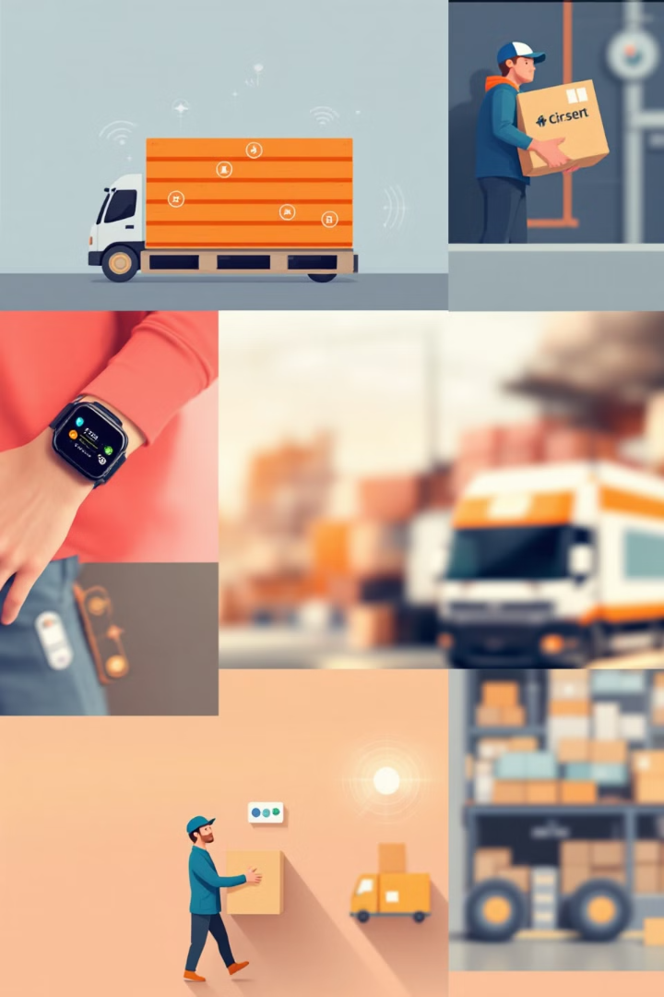
Examples of IoT Applications in Logistics: Real-World Scenarios
1
Smart Pallets
2
Connected Vehicles
Track goods in real-time.
Optimize routes and fuel.
3
Wearable Tech
Enhance worker safety.

Slide 16
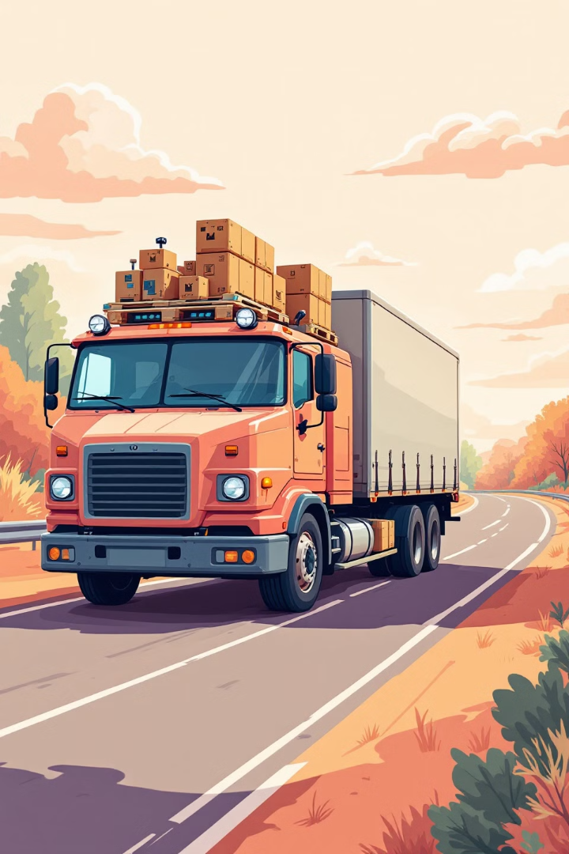



Smart Pallets and Containers: Tracking Goods Throughout the Supply Chain
Real-Time Tracking
Condition Monitoring
Security Alerts
Notify of tampering during transportation.
Follow goods through their journey.
Ensure goods are transported correctly.

Slide 17
Connected Vehicles: Optimizing Routes and Fuel Consumption
Route Optimization
Fuel Efficiency
Predictive Maintenance
Reduce delivery times with analytics.
Monitor driving behavior for reduced fuel costs.
Prevent vehicle downtime with sensor alerts.

Slide 18
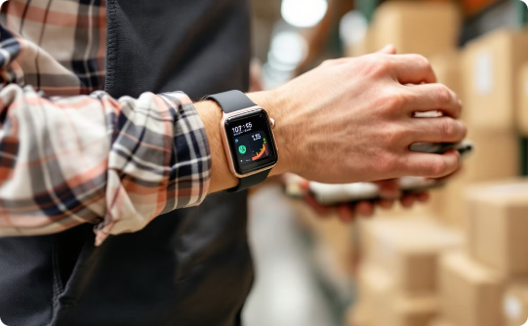

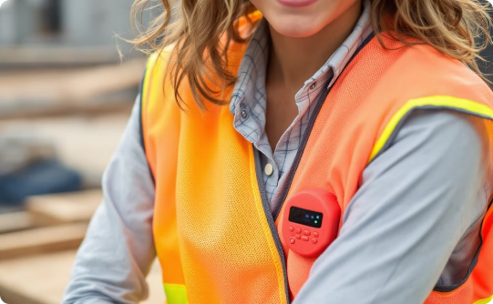
Wearable Technology for Workers: Enhancing Safety and Productivity
Smart Watches
Smart Glasses
Safety Vests
Improve communication and task management.
Hands-free navigation and information access.
Monitor worker location and vital signs.

Slide 19

Drone Delivery: Streamlining Last-Mile Logistics
Order Placement
Customer places order online.
Package Loading
Drone loads package.
Autonomous Flight
Drone navigates to destination.
Delivery Confirmation
Customer receives package.

Slide 20

Challenges and Considerations for IoT Implementation
1
Data Security
Protecting sensitive data.
2
Interoperability
Ensuring seamless integration.
3
Cost
Balancing investment and ROI.
4
Skills
Training and development.

Slide 21
Data Security and Privacy: Protecting Sensitive Information
Encryption
1
Access Control
2
4
Compliance
3
Regular Audits

Slide 22
Interoperability and Standardization: Ensuring Seamless Integration
Open Standards
API Integration
Data Formats
Promote compatibility between devices.
Enable communication between platforms.
Standardized data exchange protocols.

Slide 23
Cost of Implementation: Balancing Investment and ROI
Pilot Projects
1
Test feasibility with small-scale deployments.
Phased Rollout
2
Implement gradually to manage costs.
ROI Analysis
3
Measure the impact of IoT investments.

Slide 24

Skills Gap: Training and Developing IoT Expertise
Training Programs
Partnerships
Develop expertise in IoT technologies.
Collaborate with universities.
Hiring
Attract skilled professionals.

Slide 25

Overcoming the Challenges: Strategies for Successful IoT Adoption
1
Strategic Planning
2
Security Measures
Clearly define goals and objectives.
Implement robust security protocols.
3
Collaboration
Foster partnerships.

Slide 26

The Future of IoT in Logistics: Trends and Predictions
AI Integration
1
Advanced analytics and automation.
2
5G Connectivity
Faster and more reliable data transfer.
Digital Twins
3
Virtual representations.

