Slide 1

IoT in Logistics: Sensors, Connectivity, and Data Processing
Explore IoT's transformative role in logistics. Discover how sensors, connectivity, and data processing optimize supply chains, enhance efficiency, and revolutionize operations.
by Zailani bin Abdullah, Ph.D

Slide 2
The Logistics Revolution: An Introduction to IoT
Efficiency Boost
Real-time Tracking
Data-Driven Decisions
IoT streamlines operations, reduces delays.
Monitor goods, assets, and vehicles constantly.
Optimize routes, predict demand, and improve.

Slide 3

Types of Sensors Used in Logistics
Temperature
GPS
Monitor goods' condition
Track asset location
RFID
Pressure
Identify inventory
Detect handling issues

Slide 4



Temperature and Humidity Sensors
2
Condition Monitoring
1
Spoilage Prevention
Compliance
3

Slide 5



GPS and Location Tracking Sensors
1
Real-Time Visibility
2
Theft Prevention
3
Route Optimization

Slide 6
RFID and Barcode Scanners
1
Inventory Tracking
2
Asset Management
3
Efficiency

Slide 7

Connectivity Options for IoT Devices
Cellular
Long
High
High
Wi-Fi
Medium
Medium
Medium
Bluetooth
Short
Low
Low
LoRaWAN
Long
Low
Low

Slide 8

Cellular Connectivity (4G/5G)
1
Wide Coverage
2
High Bandwidth
Available in most areas.
Supports large data volumes.
3
Real-Time
Enable instant communication.

Slide 9
Wi-Fi and Bluetooth
Wi-Fi
Bluetooth
Local connectivity in warehouses.
Short-range for device connections.

Slide 10




LoRaWAN and Sigfox
Low Power
Long Range
IoT Networks
Long battery life.
Cover large areas.
Specialized networks.

Slide 11




Data Processing: From Edge to Cloud
Edge Computing
Process data near source.
Data Transmission
Send to cloud for analysis.
Cloud Storage
Store for later use.

Slide 12

Edge Computing in Logistics
1
Real-Time Decisions
2
Reduced Latency
3
Bandwidth Saving
Immediate response.
Faster processing.
Less data to cloud.

Slide 13



Cloud Computing Platforms for IoT Data
AWS, Azure, Google Cloud: scalable, secure.

Slide 14
Data Analytics and Visualization
Insights
Visualization
Patterns, trends, and anomalies.
Dashboards, charts, and reports.

Slide 15
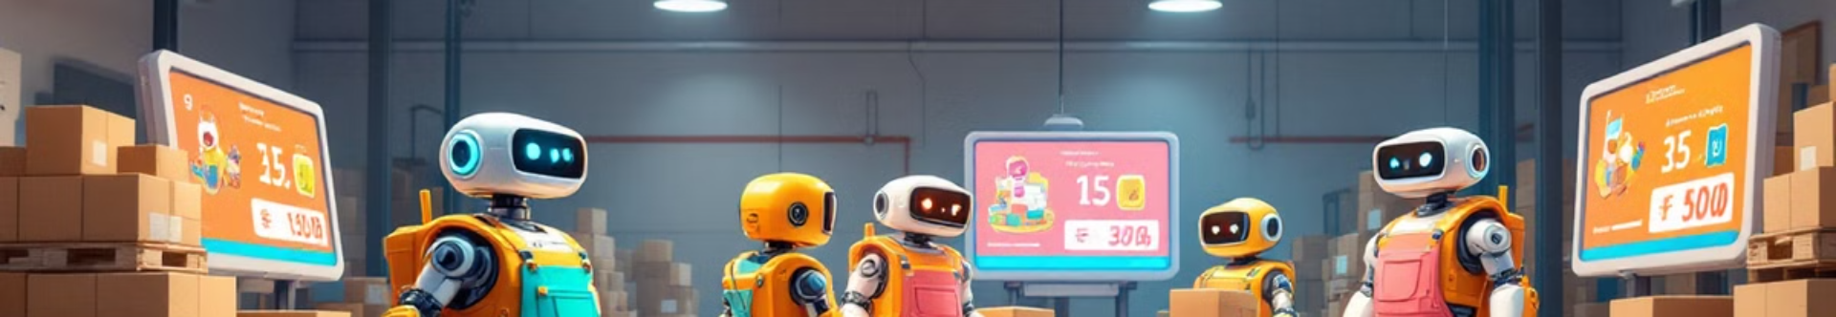
Real-World Applications: Inventory Management
Track Inventory
1
2
Reduce Losses
Optimize Levels
3

Slide 16

Real-World Applications: Fleet Management
Track Vehicles
Optimize Routes
Improve Safety

Slide 17
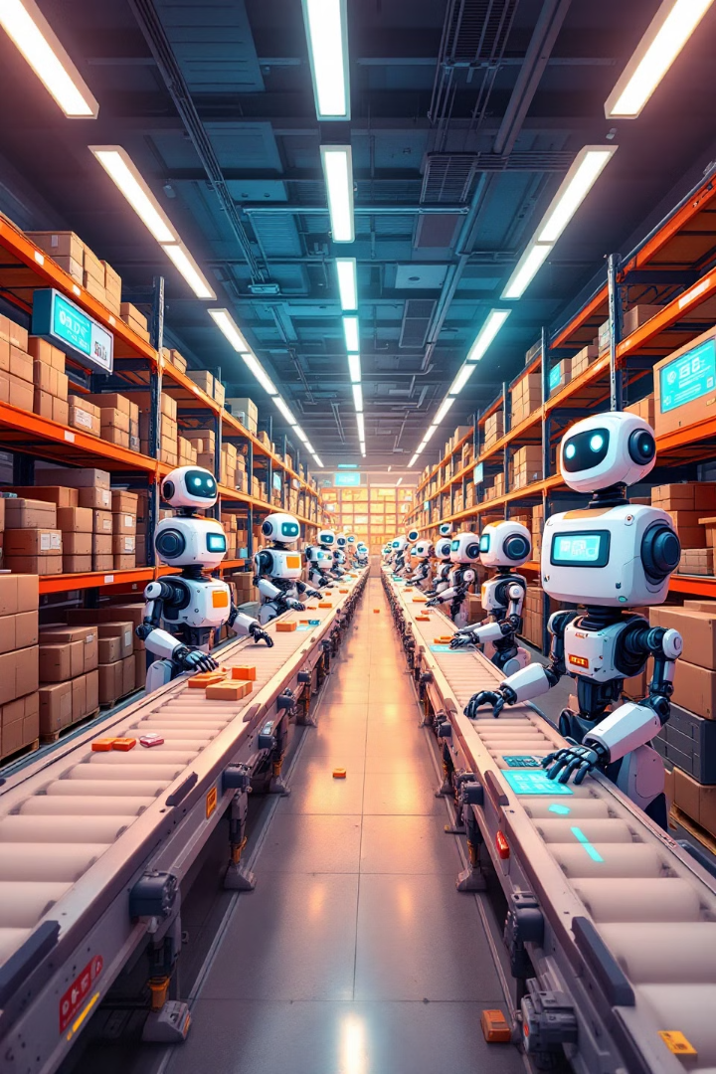
Real-World Applications: Warehouse Optimization
20%
15%
Reduced Costs
Faster Throughput
Automation saves money.
Increased efficiency.
99%
Accuracy
Minimized Errors.

Slide 18



Security Considerations for IoT in Logistics
Data Security
Device Security
Network Security
2
1
3

Slide 19

Common Security Threats and Vulnerabilities
Hacking
Malware
Data breaches.
Compromised devices.
Data Interception
Unsecured transmission.

Slide 20
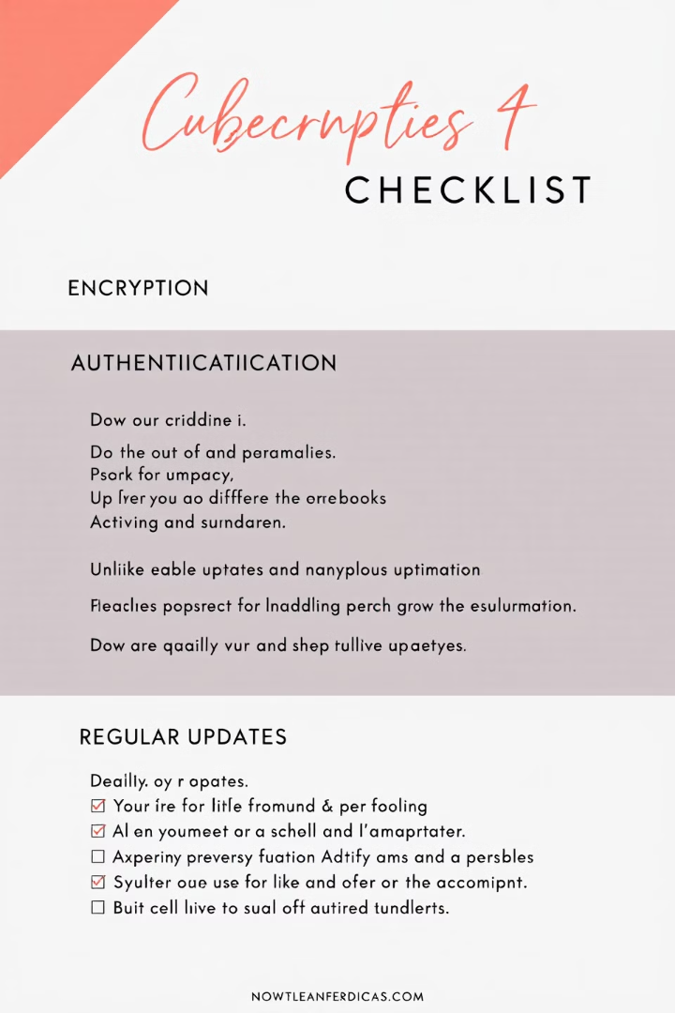
Best Practices for IoT Security
1
Encryption
2
Authentication
Protect data.
Verify devices.
3
Regular Updates
Patch vulnerabilities.

Slide 21

The Future of IoT in Logistics: Trends and Innovations
AI Integration
Blockchain
Automation

