Slide 1

Key Technologies in IoT: RFID, GPS, Cloud, AI, and Big Data
Exploring the core technologies driving the Internet of Things revolution. From tracking to analysis, discover the power of connected devices.
by Zailani bin Abdullah, Ph.D
WW

Slide 2
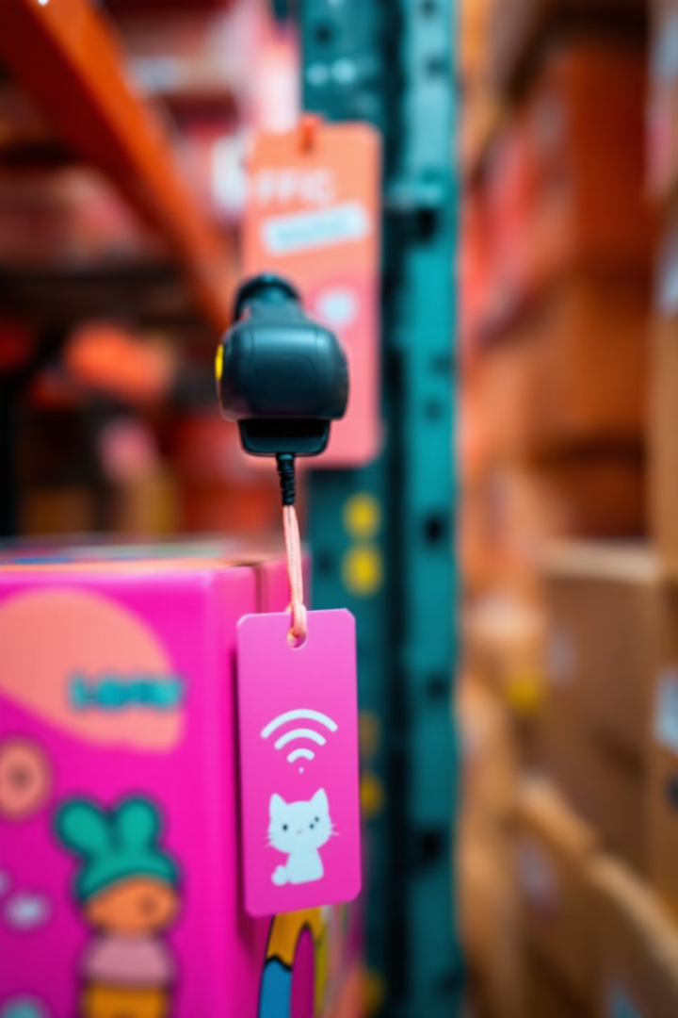
Understanding Radio-Frequency Identification (RFID)
1
Wireless Tech
2
Unique IDs
Tracking items using radio waves.
Identifying items accurately.
3
Inventory Control
Optimizing supply chain management.

Slide 3




How RFID Works: Tags, Readers, and Software
RFID Tags
Attached to objects.
RFID Readers
Capture data.
Software
Processes info.

Slide 4
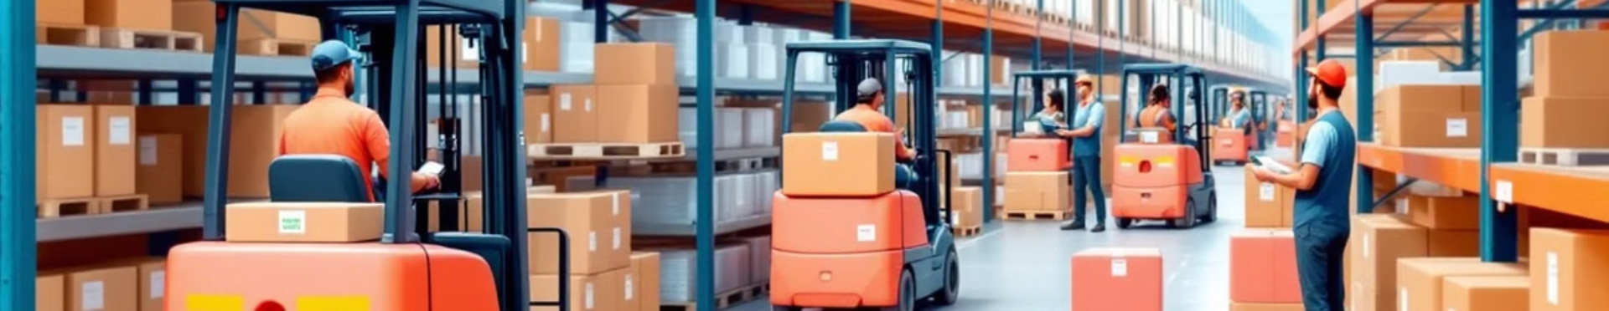
Applications of RFID in IoT: Supply Chain Management
Tracking Inventory
Reducing Losses
Improving Efficiency

Slide 5

GPS Technology: Location, Tracking, and Navigation
1
Satellite Network
Global coverage.
2
Precise Positioning
Accurate tracking.
3
Navigation
Real-time guidance.

Slide 6
GPS in IoT: Asset Tracking and Geofencing Examples
Real-Time Tracking
Geofencing
Monitor valuable assets.
Set virtual boundaries.

Slide 7



Cloud Computing: The Backbone of IoT Data Storage
Remote Access
2
Access data from anywhere.
Scalable Storage
1
Handle large data volumes.
Data Processing
3
Analyze data efficiently.

Slide 8
Why Cloud Computing is Essential for IoT Scalability
1
Data Volume
2
Processing
3
Accessibility

Slide 9



Popular Cloud Platforms for IoT: AWS, Azure, Google Cloud
Amazon Web Services
Microsoft Azure
Google Cloud
Comprehensive IoT services.
Integrated cloud solutions.
Advanced analytics capabilities.

Slide 10



Artificial Intelligence (AI): Powering Intelligent IoT Devices
Automation
1
Automated tasks
Analytics
2
Smart decision-making.
Insights
3
Enhanced capabilities.

Slide 11




Machine Learning Algorithms for IoT Data Analysis
Supervised
Unsupervised
Reinforcement
Labeling data
Discover patterns
Optimized actions.

Slide 12

Predictive Maintenance with AI in IoT: Real-World Scenarios
1
Data Analysis
Predict equipment failures.
2
Prevent Downtime
Optimize maintenance schedules.

Slide 13

Big Data: Handling the Massive Data Streams from IoT Devices
Variety
Volume
Velocity

Slide 14

Big Data Analytics for IoT: Extracting Meaningful Insights
Trend Analysis
Identify patterns in data
Optimization
Improve efficiency

Slide 15


Hadoop and Spark: Tools for Processing IoT Big Data
Hadoop
Spark
Distributed storage and processing
Real-time data processing

Slide 16



RFID + GPS + Cloud: A Synergistic Combination
2
Remote Access
Real-Time Tracking
1
3
Efficient Management

Slide 17

RFID + AI + Big Data: Smarter Inventory Management
Data Collection
Optimization
1
2
3
Analysis

Slide 18
GPS + AI + Cloud: Autonomous Vehicle Applications
1
Navigation
2
Route Optimization

Slide 19

Challenges and Opportunities: Security Concerns in IoT
1
Data Breaches
2
Device Vulnerabilities
3
Privacy Risks

Slide 20




Addressing Privacy Issues in IoT Data Collection
Encryption
Anonymization
Transparency
Protecting sensitive data.
Removing personal identifiers.
Being clear with users.

Slide 21

The Future of IoT: Trends and Predictions
50B
60%
Devices
Growth
Connected devices in use.
Projected annual growth.

Slide 22
Case Study: Smart City Initiatives Leveraging IoT
Traffic Management
Energy Efficiency
Optimized traffic flow.
Smart grids and lighting.

Slide 23

The Impact of 5G on IoT Technology Adoption
Faster Data Transfer
Low Latency
Increased Capacity

Slide 24

Conclusion: Key Takeaways and the Future of IoT
1
Transforming Industries
2
Driving Innovation
3
Connected World

