Slide 1

IoT Architecture in Logistics: Optimizing the Supply Chain
Explore how IoT is transforming logistics, enhancing efficiency, and creating smarter supply chains.
by Zailani bin Abdullah, Ph.D
WW

Slide 2
Introduction: The Rise of IoT in Logistics
Increased Efficiency
Real-time Visibility
Cost Reduction
Automation reduces manual tasks.
Track goods and assets in transit.
Optimize routes and resource allocation.

Slide 3


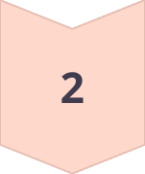

The Three Core Layers of IoT Architecture
Device Layer
Sensors and actuators.
Network Layer
Connectivity and data transmission.
Application Layer
Data processing and visualization.

Slide 4

Device Layer: The Foundation of IoT
Purpose
Components
Collects raw data from physical assets.
Sensors, actuators, and embedded systems.
Function
Enables real-time data capture and control.

Slide 5
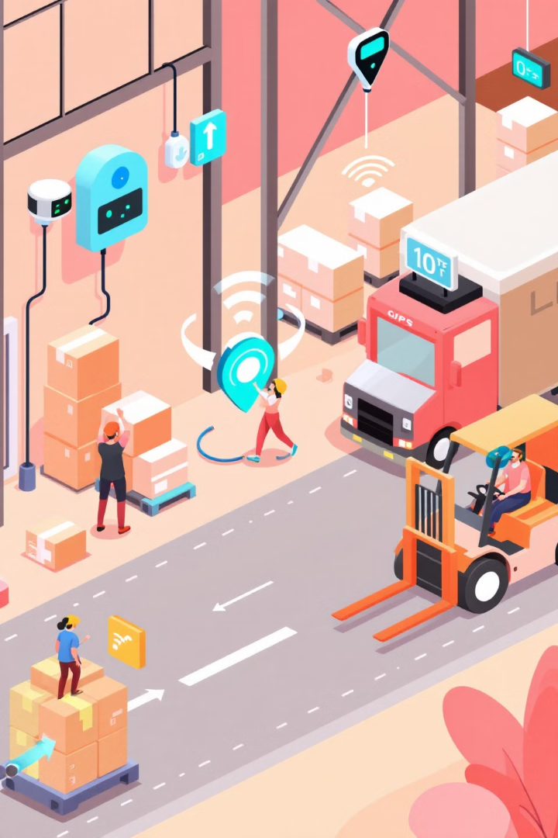



Sensors and Actuators in Logistics
Temperature Sensors
GPS Trackers
Accelerometers
Track location of vehicles and shipments.
Detect impacts and vibrations.
Monitor temperature-sensitive goods.

Slide 6

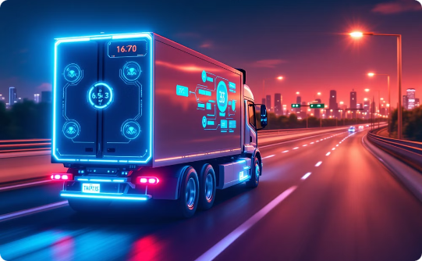
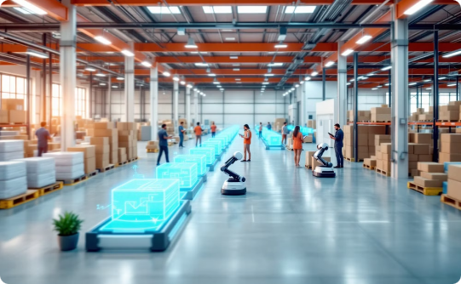
Real-World Examples of IoT Devices
Smart Pallets
Connected Vehicles
Smart Warehouses
Track location and condition of goods.
Monitor vehicle performance and location.
Automate inventory and tracking processes.

Slide 7



Hardware Considerations: Power and Connectivity
2
Battery Life
1
Power
Connectivity
3

Slide 8
Data Acquisition and Pre-processing
Collection
1
Gather raw data.
Filtering
2
Remove noise and errors.
Aggregation
3
Summarize data for analysis.

Slide 9



Network Layer: Connecting Devices to the Cloud
1
Cloud
2
Network
3
Devices

Slide 10




Wireless Communication Technologies
Wi-Fi
Bluetooth
Cellular

Slide 11
Low-Power Wide-Area Networks (LPWAN)
LoRaWAN
NB-IoT
Long-range, low-power communication protocol.
Cellular-based technology for massive IoT deployments.

Slide 12

Network Security Considerations
1
Encryption
2
Authentication
Protect data in transit and at rest.
Verify device and user identities.
3
Access Control
Limit access to sensitive data and functions.

Slide 13

Data Transmission Protocols
Protocol
Description
MQTT
Lightweight messaging protocol.
CoAP
Web protocol for constrained devices.

Slide 14

Edge Computing in the Network Layer
Data Processing
Process data closer to the source.
Reduced Latency
Minimize delays in decision-making.
Improved Bandwidth
Reduce data transmission to the cloud.

Slide 15
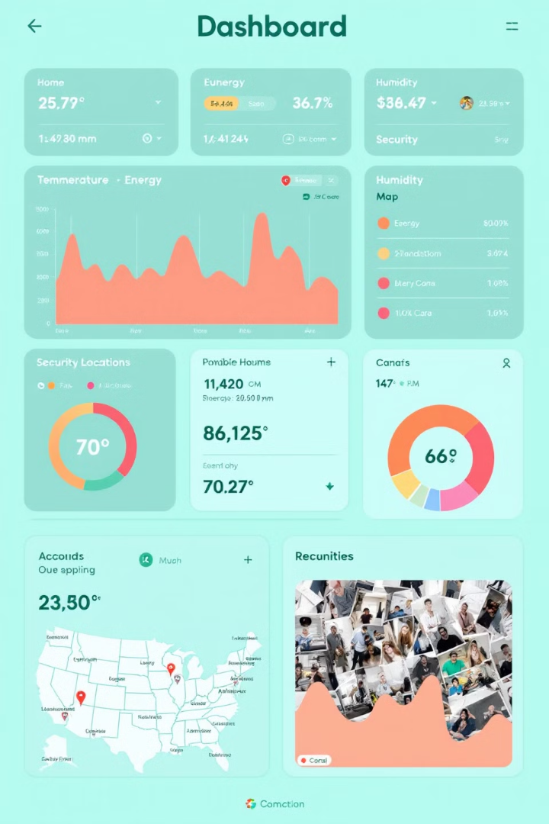
Application Layer: Turning Data into Action
Purpose
Functions
Transforms data into actionable insights.
Data analytics, visualization, and reporting.
Benefits
Improved decision-making and automation.

Slide 16




Cloud-Based IoT Platforms
AWS IoT
Azure IoT
Google Cloud IoT

Slide 17
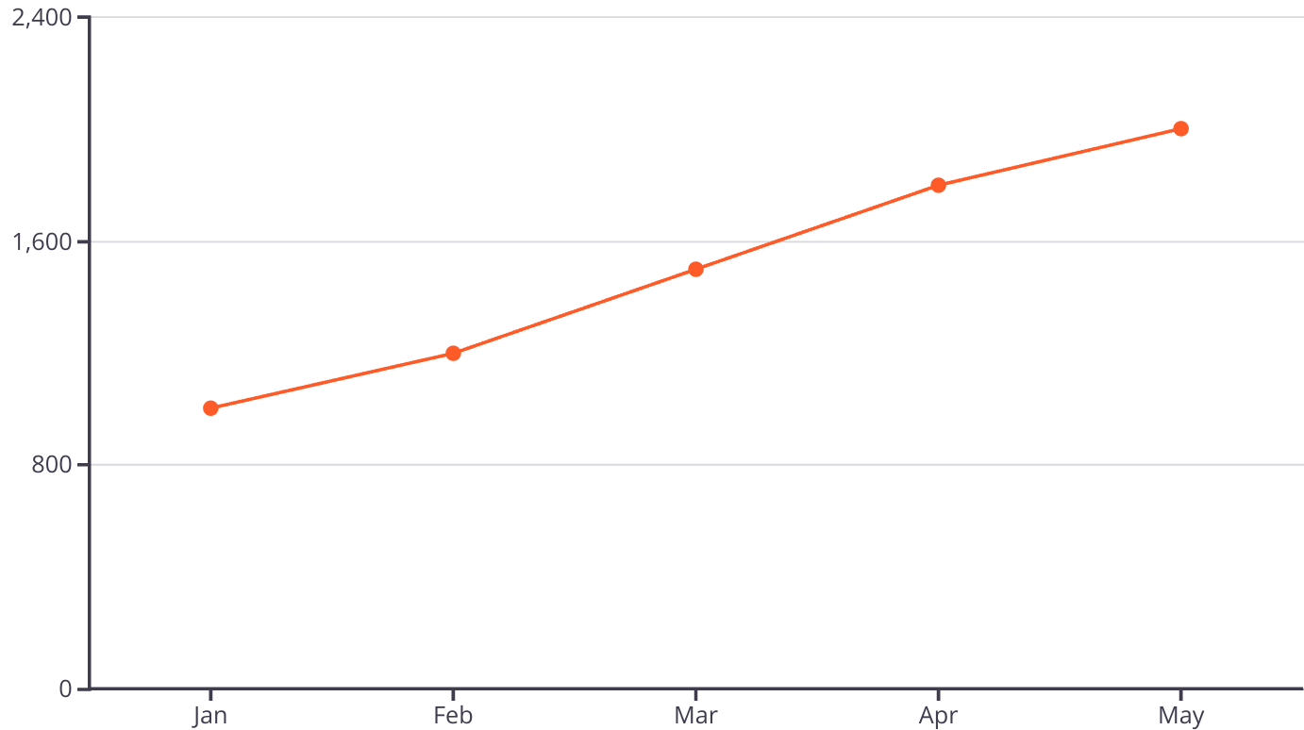
Data Analytics and Visualization
Visualizing deliveries over time helps optimize resource allocation.

Slide 18
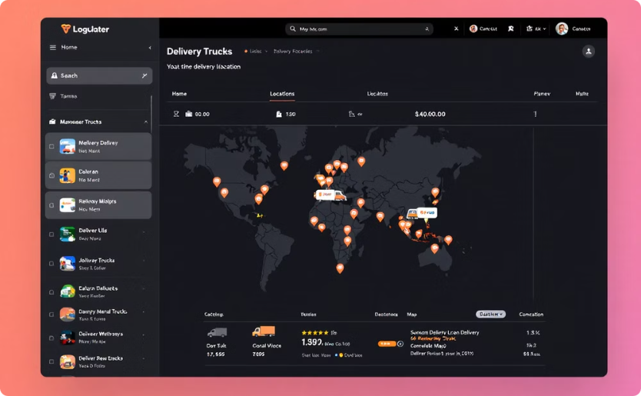

Real-Time Tracking and Monitoring Applications
Vehicle Tracking
Condition Monitoring

Slide 19
Predictive Maintenance for Logistics Vehicles
Data Collection
1
Collect sensor data from vehicles.
Analysis
2
Analyze data for patterns.
Prediction
3
Predict maintenance needs.

Slide 20
Inventory Management and Optimization
2
Optimization
1
Tracking
Management
3

Slide 21

Security in the Application Layer
Measure
Description
Authentication
Secure user access.
Data Validation
Ensure data integrity.

Slide 22

Case Study: IoT Implementation in Logistics
Company
Solution
Results
Global shipping company.
Real-time tracking and condition monitoring.
Reduced losses and improved efficiency.

Slide 23

Challenges and Future Trends in IoT Logistics
1
Challenges
Security, scalability, and interoperability.
2
Trends
AI, 5G, and blockchain integration.

