Slide 1

Real-time Tracking and Monitoring in Logistics: GPS, RFID, and Geofencing
Explore GPS, RFID, and geofencing for enhanced shipment visibility.
by Zailani bin Abdullah, Ph.D
WW

Slide 2
The Need for Shipment Visibility in Modern Logistics
Customer expectations
Supply chain complexity
Competitive pressure
Demand for transparency
Global networks
Cost efficiency

Slide 3




Introduction to Real-time Tracking Technologies
GPS
RFID
Geofencing
Global Positioning System
Radio-Frequency Identification
Virtual boundaries

Slide 4
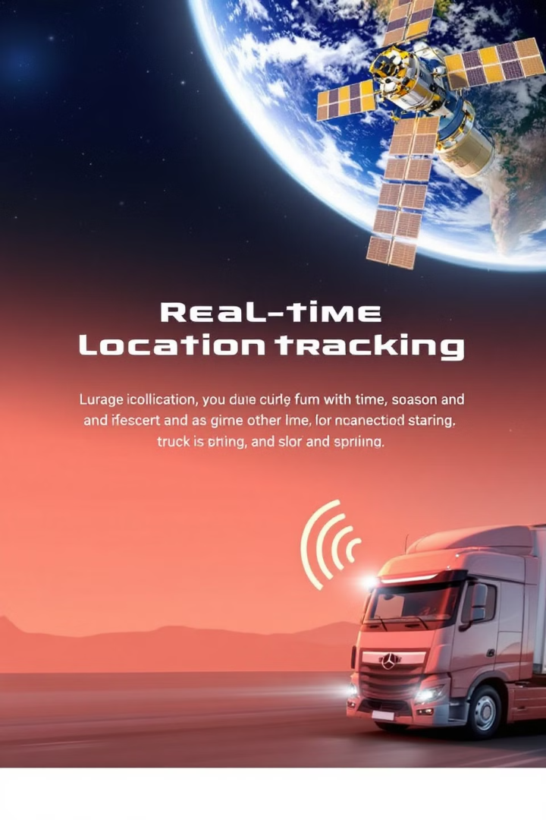
Deep Dive: Global Positioning System (GPS) for Logistics
1
Satellite network
2
Triangulation
Constellation of satellites
Calculating location
3
Real-time data
Continuous updates

Slide 5
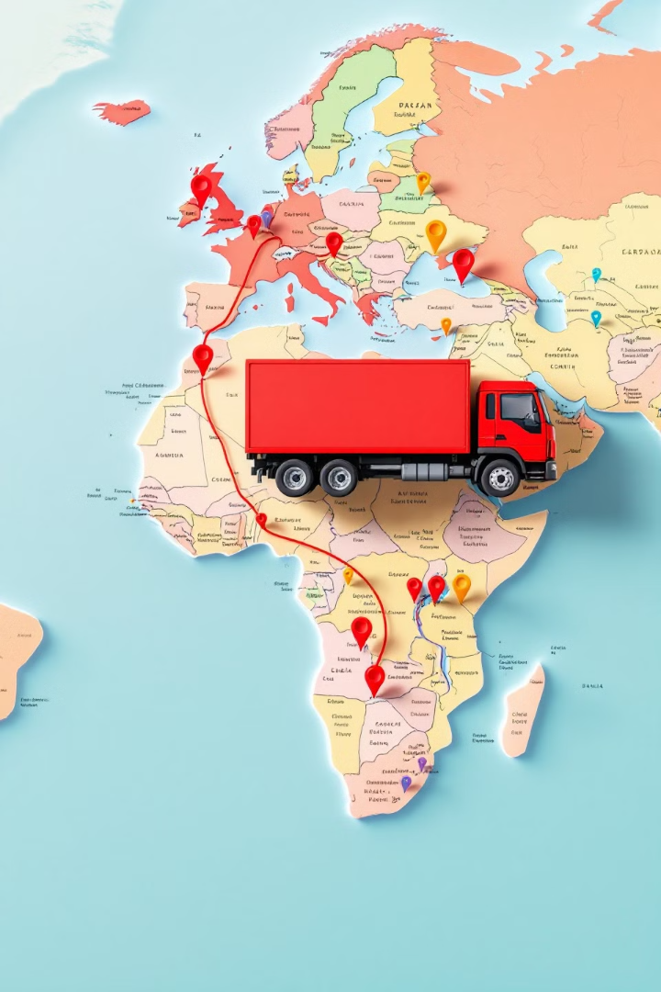



GPS Tracking Benefits: Precision and Coverage
Accuracy
Precise location data
Wide coverage
Global tracking
Real-time monitoring
Instant updates

Slide 6
Challenges of GPS Implementation in Logistics
Signal obstruction
1
Urban canyons, tunnels
Power consumption
2
Battery life
Cost
3
Hardware and data plans

Slide 7



Radio-Frequency Identification (RFID) Explained
Readers
2
Detect tags
Tags
1
Attached to items
Data
3
Transmitted wirelessly

Slide 8
RFID Applications in Warehouse Management
Inventory control
Asset management
Order fulfillment
Automated tracking
Locating equipment
Efficient picking

Slide 9

RFID for Tracking Goods in Transit
Real-time visibility
Reduced loss
Monitor goods
Prevent theft
Improved security
Secure supply chain

Slide 10

Advantages of RFID over Traditional Methods
1
Automation
2
Speed
Reduced manual labor
Faster scanning
3
Accuracy
Minimized errors

Slide 11
Limitations of RFID Technology in Logistics
Read range
1
Limited distance
Material interference
2
Metal, liquids
Cost
3
Tagging every item

Slide 12
Understanding Geofencing Technology
Triggers
2
Entry/exit alerts
Virtual perimeter
1
Defined area
Actions
3
Notifications, security

Slide 13

How Geofencing Enhances Security and Efficiency
Theft prevention
Alerts for unauthorized exits
Route optimization
Ensuring compliance
Automated workflows
Streamlined processes

Slide 14

Setting up Virtual Boundaries for Shipment Alerts
1
Define areas
2
Set rules
Warehouses, depots
Entry/exit triggers
3
Configure alerts
Notifications

Slide 15
Real-world Applications: Geofencing in Action
Delivery confirmation
Cold chain monitoring
Equipment tracking
Automatic proof of delivery
Temperature compliance
Locating assets

Slide 16




Integrating GPS, RFID, and Geofencing for Comprehensive Tracking
GPS
RFID
Geofencing
Location
Identification
Security

Slide 17
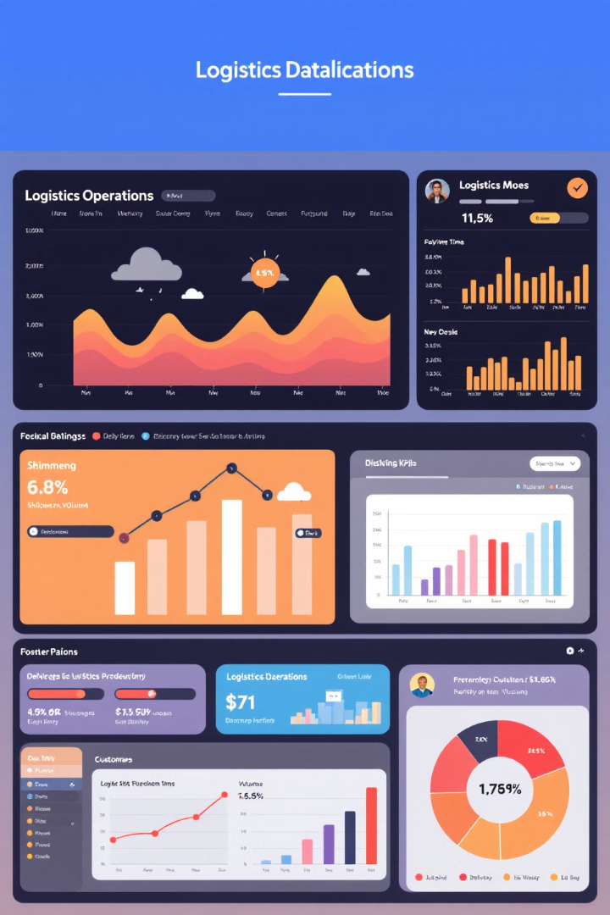
Data Analytics and Reporting for Informed Decisions
95%
30%
Delivery Success
Reduced Loss
On-time rate
Theft prevention
15%
Cost Savings
Route optimization

Slide 18
Case Study 1: Improving Delivery Times with Real-time Tracking
Challenge
Solution
Results
Late deliveries
Real-time tracking
Faster delivery times

Slide 19

Case Study 2: Reducing Theft and Loss with Geofencing
Challenge
Solution
Cargo theft
Geofencing alerts
Results
Reduced losses

Slide 20

The Future of Real-time Tracking in Logistics
1
Enhanced visibility
End-to-end tracking
2
Automation
Smart logistics
3
Predictive analytics
Proactive decision-making

