Slide 1

Predictive Maintenance in Logistics: IoT Sensors for Fleet and Equipment
Discover how IoT sensors are revolutionizing fleet and equipment maintenance in logistics, driving efficiency and cost savings.
by Zailani bin Abdullah, Ph.D
WW

Slide 2
The Rising Costs of Unplanned Downtime in Logistics
Lost Productivity
Expensive Repairs
Missed Deadlines
Unforeseen breakdowns halt operations.
Emergency maintenance incurs high costs.
Late deliveries damage reputation.

Slide 3

Introducing Predictive Maintenance: A Proactive Approach
1
Anticipate Failures
2
Optimize Maintenance
Identify potential issues before they occur.
Schedule maintenance only when needed.
3
Minimize Downtime
Reduce disruptions and improve uptime.

Slide 4




Core Concepts: IoT, Sensors, Data Analytics, and Machine Learning
IoT
1
Sensors
Connect devices.
2
Gather data.
Machine Learning
4
Data Analytics
3
Predict failures.
Process insights.

Slide 5




IoT Sensors: The Eyes and Ears of Predictive Maintenance
Real-Time Data
Early Detection
Connectivity
Continuous monitoring of equipment health.
Identify subtle changes indicating potential issues.
Seamless data transmission to analytics platforms.

Slide 6

Common Sensor Types: Vibration, Temperature, Pressure, and Acoustic
Vibration
Detect imbalances and wear.
Temperature
Monitor overheating issues.
Pressure
Track fluid and gas levels.
Acoustic
Identify unusual noises.

Slide 7




Real-World Applications: Fleet Maintenance
Engine Monitoring
Optimize performance.
Tire Pressure
Extend tire life.
Brake Health
Ensure safety.

Slide 8
Case Study: Reducing Truck Downtime with Sensor-Based Monitoring
Challenge
Solution
Results
High downtime, repair costs.
Sensor-based monitoring system.
Reduced downtime by 30%.

Slide 9
Real-World Applications: Warehouse Equipment Maintenance
Forklifts
1
Battery health.
Conveyor Belts
2
Wear detection.
Automated Systems
3
Performance Optimization.

Slide 10
Case Study: Optimizing Conveyor Belt Performance
Challenge
Solution
Results
Belt failures, halts.
Vibration and alignment monitoring.
Increased throughput by 20%.

Slide 11
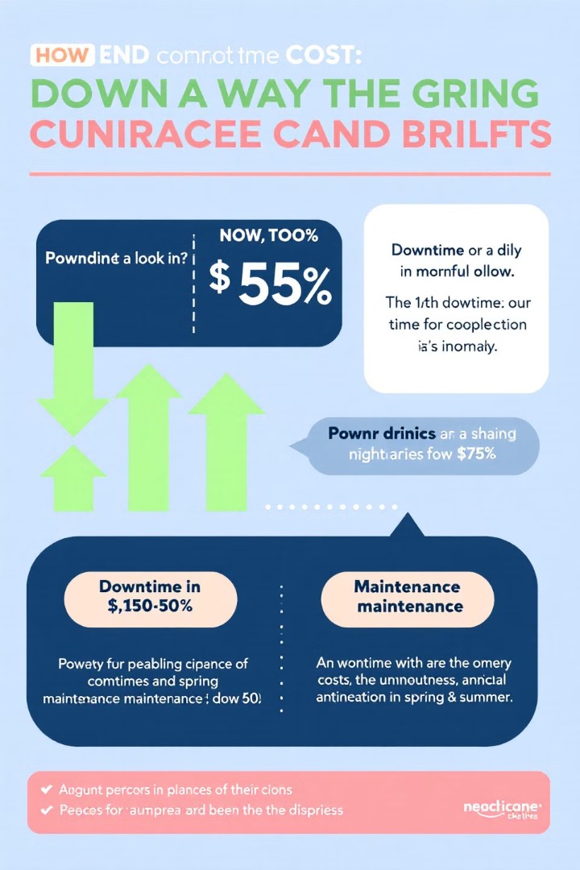
Benefits: Reduced Downtime, Lower Maintenance Costs
30%
Downtime
Less disruptions.
25%
Costs
Savings, efficiency.

Slide 12

Benefits: Extended Equipment Lifespan, Improved Efficiency
Extended Equipment Lifespan
Reduced wear, tear.
Improved Efficiency
Optimized operations, streamlined workflows.

Slide 13





Data Collection and Processing: From Sensors to Insights
Sensor Data
Raw measurements collected.
Data Transmission
Secure data transfer.
Data Processing
Cleaning & transformation.
Actionable Insights
Data to improve decisions.

Slide 14

Data Analytics: Turning Raw Data into Actionable Intelligence
1
Identify Patterns
2
Detect Anomalies
Uncover hidden trends.
Flag unusual data.
3
Predict Trends
Anticipate future issues.

Slide 15




Machine Learning: Predicting Failures Before They Happen
Algorithms
Predictions
Automation
Train data models.
Identify the trends early.
Maintenance optimization.

Slide 16

Challenges in Implementation: Data Security and Privacy
1
Encryption
2
Access
Secure sensor data.
Control access to sensitive data.
3
Compliance
Adhere to privacy regulations.

Slide 17

Challenges in Implementation: Sensor Selection and Placement
Environment
Location
Select durable sensors.
Optimal placement for accurate data.
Compatibility
Ensure with existing systems.

Slide 18
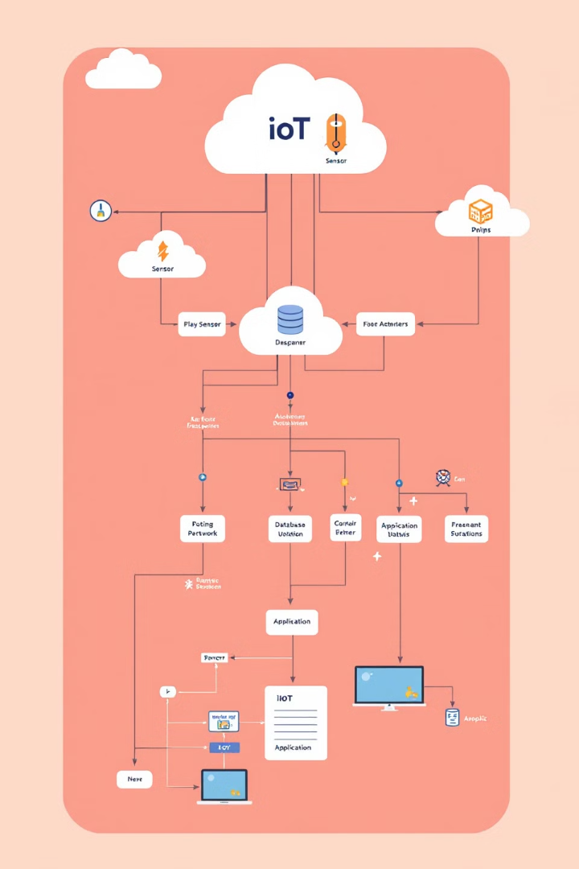
Challenges in Implementation: Integrating with Existing Systems
1
Legacy
Evaluate legacy.
2
APIs
Use APIs for data exchange.
3
Migration
Implement a phased rollout.

Slide 19
Overcoming Challenges: Best Practices and Strategies
Planning
Collaboration
Develop a plan.
Involve stakeholders.

Slide 20



Future Trends: Edge Computing and AI-Driven Predictive Maintenance
Edge
AI-Driven
Process data locally.
Enhance prediction accuracy.

Slide 21



Future Trends: Digital Twins for Predictive Simulation
1
Simulation
2
Optimization
3
Prediction
Digital Twins are the new way to simulate real-world conditions to make better predictions.

