Slide 1
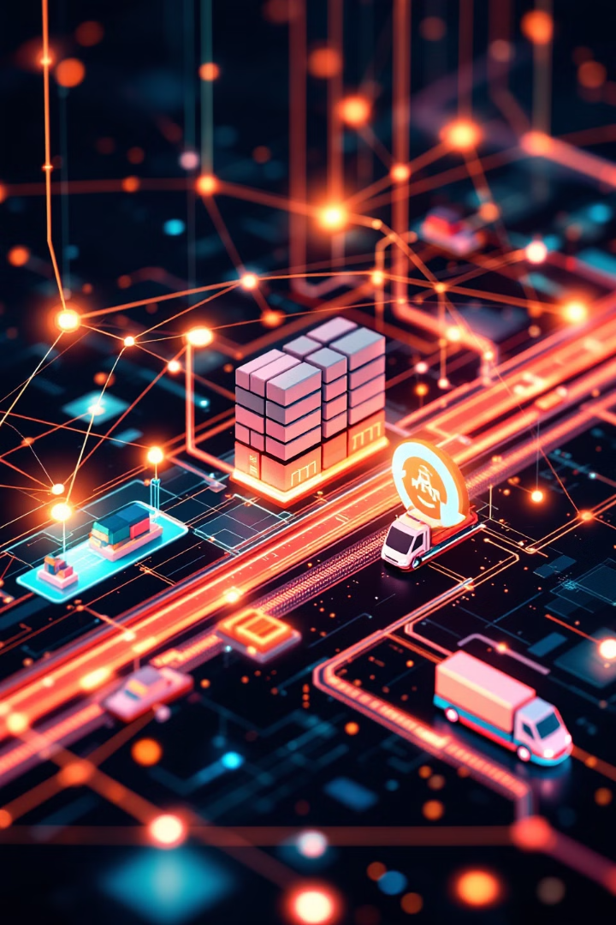
Supply Chain Optimization: AI-Driven Logistics
Explore how AI is transforming supply chain management. Unlock efficiency and resilience in logistics through cutting-edge technology.
by Zailani bin Abdullah, Ph.D
WW

Slide 2
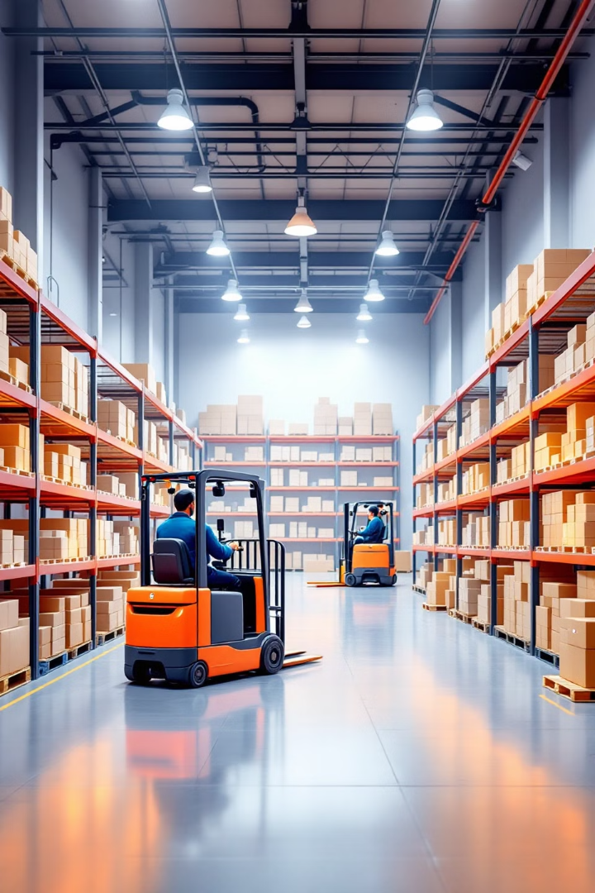
Agenda: Revolutionizing Logistics with AI
1
Current Challenges
Understanding supply chain pain points.
2
AI Overview
The promise of AI in logistics.
3
Route Planning
AI-driven route optimization.
4
Demand Forecasting
Predicting future demand with AI.

Slide 3
Understanding Current Supply Chain Challenges
Rising Costs
Inefficiencies
Lack of Visibility
Fuel, labor, and transportation expenses.
Manual processes, errors, delays.
Difficulty tracking goods in real-time.

Slide 4




The Promise of AI in Logistics: An Overview
Efficiency
Cost Savings
Visibility
Optimizing routes, reducing delays.
Lowering fuel and operational expenses.
Real-time tracking, predictive insights.

Slide 5
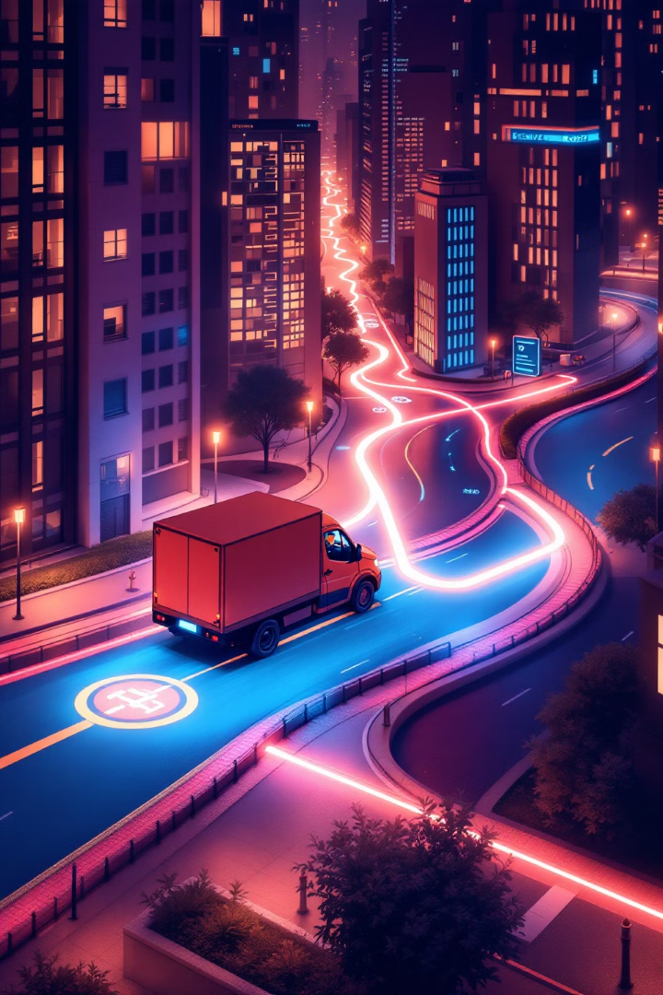



Deep Dive: AI-Driven Route Planning
Data Collection
Gathering traffic, weather, and delivery data.
Algorithm Application
AI analyzes data to find optimal routes.
Real-Time Adjustment
Adapting to changing conditions dynamically.

Slide 6
Traditional Route Planning vs. AI Optimization
Traditional
AI Optimization
Manual, time-consuming, static routes.
Automated, real-time, adaptive routes.

Slide 7

Case Study 1: Fuel Efficiency Gains with AI Routing
15
10
% Reduction
% Faster
Fuel consumption decrease.
Delivery times improved.
$50K
Savings
Annual fuel cost savings.

Slide 8



Demand Forecasting: Predicting the Future
Accuracy
1
Improve prediction of future demand.
Efficiency
2
Reduce overstocking and stockouts.
Profitability
3
Optimize inventory levels.

Slide 9
Statistical Methods vs. AI-Powered Forecasting
Statistical
AI-Powered
Historical data, limited variables.
Real-time data, multiple variables.

Slide 10

Machine Learning Algorithms for Demand Prediction
Regression
Classification
Time Series
Predicting continuous values.
Categorizing data into groups.
Analyzing patterns over time.

Slide 11
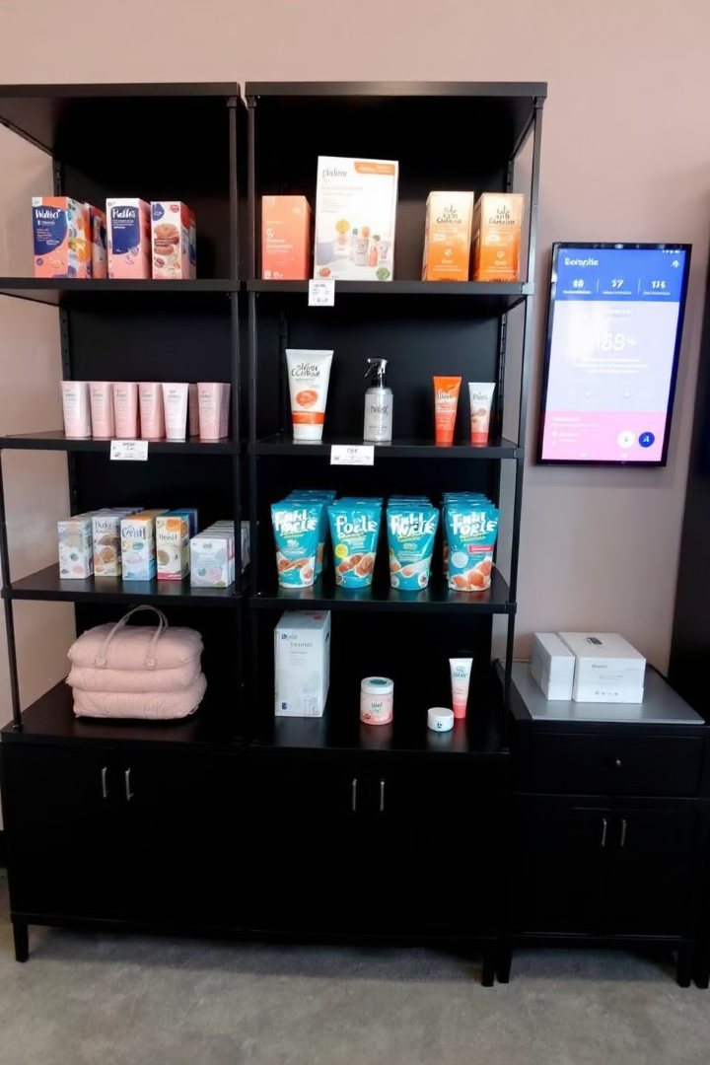
Case Study 2: Reducing Inventory Waste with AI
20
12
% Reduction
% Increase
Inventory waste decreased.
Sales increased due to optimal stock.
$75K
Savings
Annual savings on inventory costs.

Slide 12
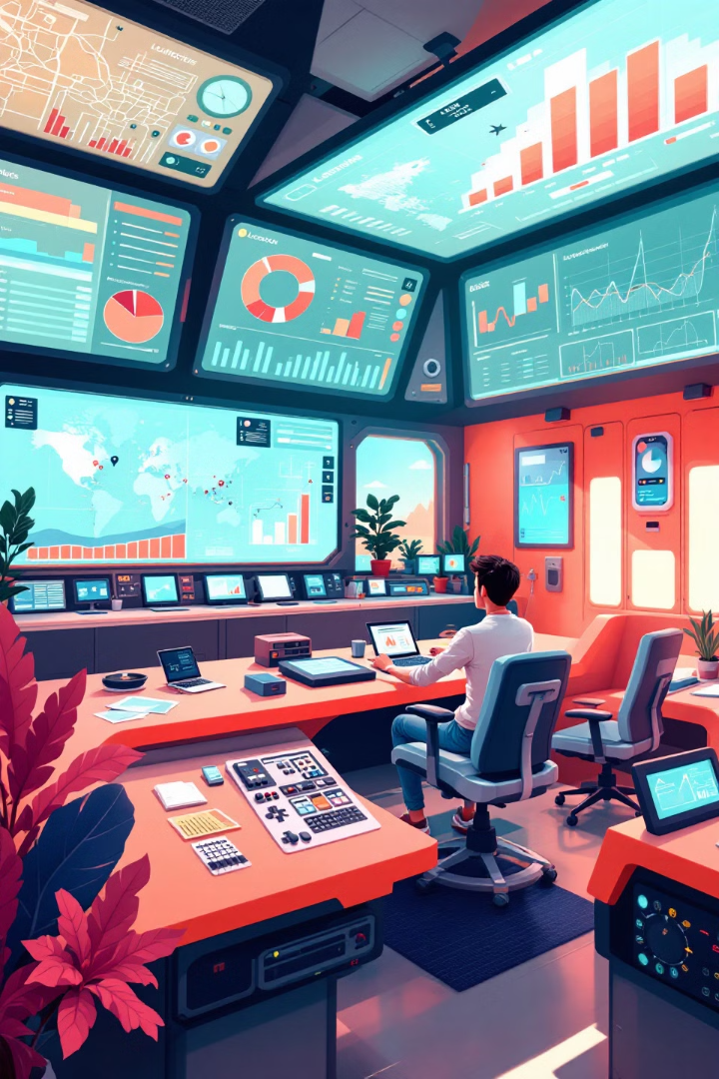
Real-Time Monitoring and Adaptive Optimization
1
Data Streams
Constant flow of logistics information.
2
AI Analysis
Processing data for insights.
3
Optimization
Dynamic adjustments to routes and plans.

Slide 13




The Role of IoT in Supply Chain Visibility
Sensors
Connectivity
Data Analytics
Tracking location and condition.
Enabling real-time data transmission.
Providing actionable insights.

Slide 14




Using AI to Respond to Disruptions Dynamically
Identify
Detecting disruptions in real-time.
Analyze
Assessing the impact of disruptions.
Adapt
Adjusting routes and schedules dynamically.

Slide 15
Challenges in Implementing AI in Logistics
Data
1
Quality and availability.
Integration
2
Compatibility with systems.
Security
3
Privacy and compliance.

Slide 16
Data Quality and Availability Hurdles
Incomplete Data
Siloed Data
Missing or inaccurate information.
Data spread across different systems.

Slide 17



Integration with Existing Systems
Scalability
2
Adapting AI to changing business needs.
Compatibility
1
Ensuring AI works with legacy systems.
Maintenance
3
Ongoing support and updates.

Slide 18

Addressing Security and Privacy Concerns
1
Data Encryption
2
Access Control
Protecting sensitive information.
Limiting who can view data.
3
Compliance
Adhering to regulations.

Slide 19

The Future of AI in Supply Chain
Automation
AI will automate many tasks.
Prediction
AI will give foresight.
Optimization
Efficiency will be automated.

Slide 20
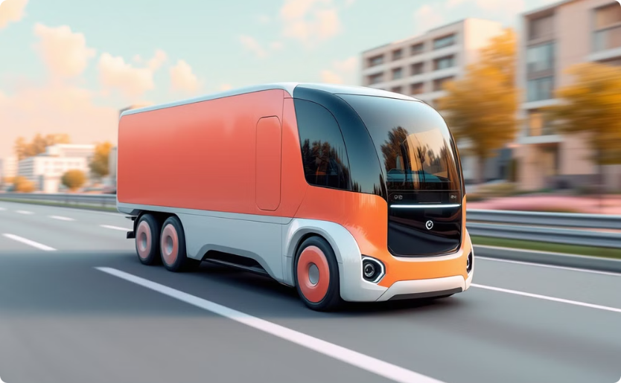

Autonomous Vehicles and Delivery Systems
Autonomous Trucks
Drone Delivery
Reducing labor costs, increasing efficiency.
Fast, last-mile delivery solutions.

Slide 21
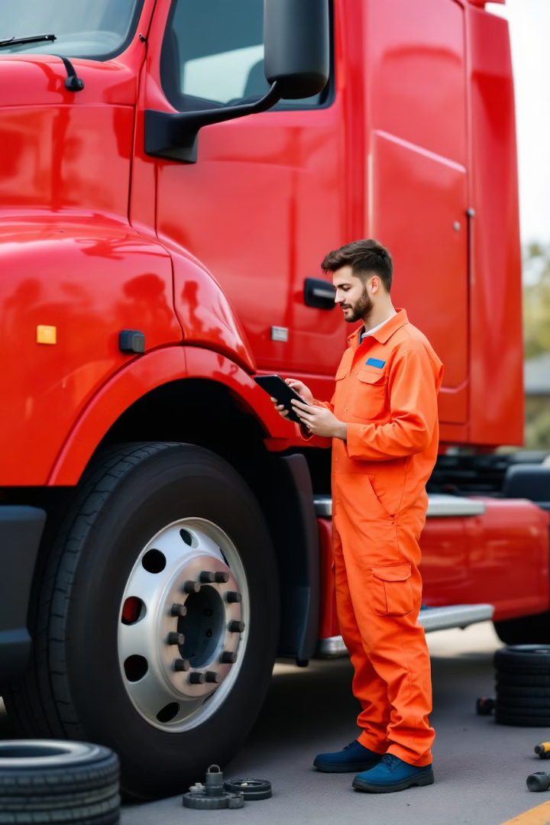
Predictive Maintenance for Logistics Assets
1
Sensors
Monitor condition.
2
AI Analysis
Predict failures.
3
Maintenance
Schedule repairs proactively.

Slide 22

Ethical Considerations in AI Implementation
Bias
Transparency
Avoiding skewed data.
Explainable AI.
Fairness
Equal practices for all parties.

Slide 23

Conclusion: Key Takeaways for Optimization
1
AI
2
IoT
Optimizes routes and forecasting.
Enables visibility.
3
Ethics
Is a key component of AI.

