Slide 1
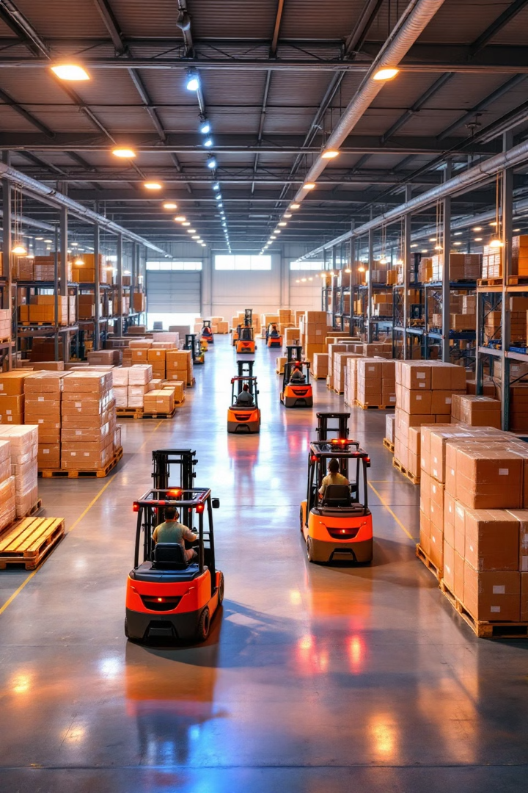
Cold Chain Management: Preserving Perishables Through Temperature Monitoring
Maintaining product integrity from origin to consumer.
by Zailani bin Abdullah
WW

Slide 2
What is the Cold Chain? Definition and Importance
Definition
Importance
Components
Temperature-controlled supply chain.
Preserves perishables, ensures safety.
Refrigeration, monitoring, transport.

Slide 3
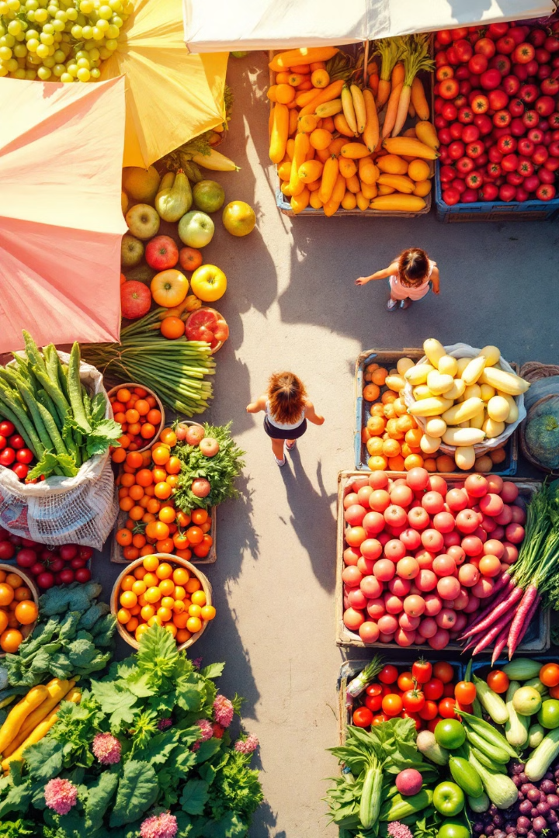
The Perishable Goods Landscape: Challenges & Opportunities
1
Challenges
2
Opportunities
Spoilage, waste, regulations.
Efficiency, new markets, sustainability.
3
Goods
Food, pharma, chemicals, electronics.

Slide 4

Why Temperature Monitoring Matters: Impact on Quality & Safety
Quality
Safety
Maintains freshness, flavor, efficacy.
Prevents bacterial growth, toxins.
Compliance
Meets regulatory requirements, standards.

Slide 5




Regulatory Compliance: Standards and Guidelines (e.g., FDA, EU)
FDA
EU
Standards
Food and Drug Administration.
European Union regulations.
ISO, HACCP, GMP.

Slide 6

Core Components of Cold Chain Management
1
Storage
Refrigerated warehouses, freezers.
2
Transportation
Refrigerated trucks, containers.
3
Monitoring
Sensors, data loggers, software.
4
Packaging
Insulated containers, refrigerants.

Slide 7




Temperature Monitoring Technologies: Sensors, Data Loggers, and IoT
Sensors
Measure temperature.
Data Loggers
Record data over time.
IoT
Real-time tracking, connectivity.

Slide 8
Real-time Monitoring vs. Periodic Checks: Advantages and Disadvantages
Real-time
Periodic
Accuracy
Continuous, immediate alerts.
Snapshot, manual checks.
Increased accuracy, reduced risk.

Slide 9




Wireless Sensor Networks (WSNs) for Cold Chain Monitoring
Sensors
1
Network
Collect data.
2
Transmit wirelessly.
Data
4
Gateway
3
Processed and analyzed.
Connect to cloud.

Slide 10



Cloud-based Platforms for Data Analysis and Visualization
1
Insights
2
Analysis
3
Data

Slide 11
Data Analytics: Identifying Trends and Anomalies
1
Patterns
2
Insights
3
Action

Slide 12
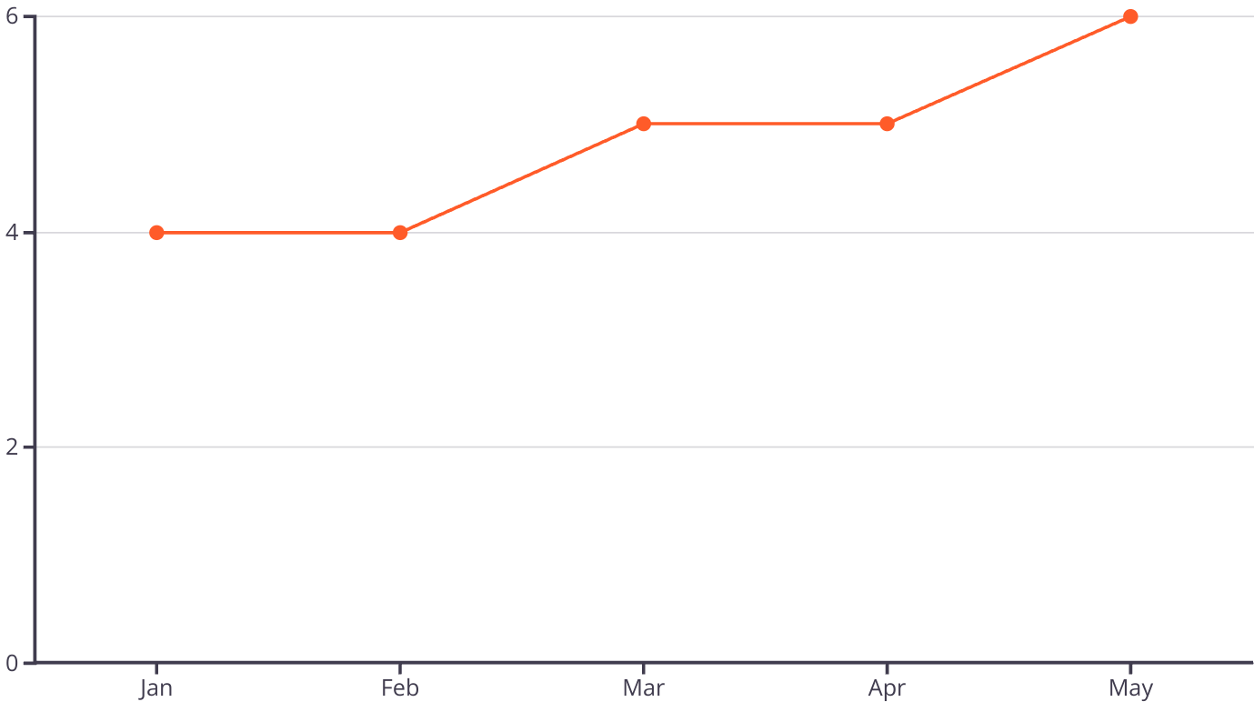
Predictive Analytics: Preventing Spoilage and Waste
Predicting temperature deviations, minimizing risks.

Slide 13
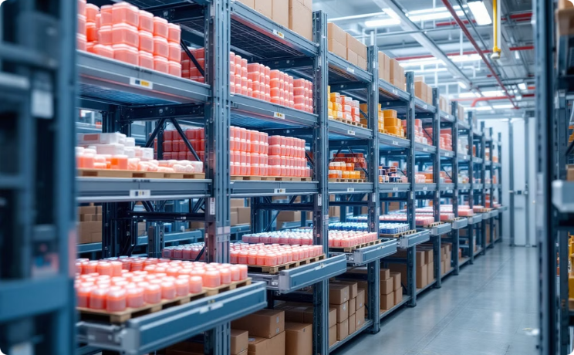
Case Study 1: Pharmaceutical Cold Chain Success
Vaccine distribution
Improved delivery, ensured potency.

Slide 14
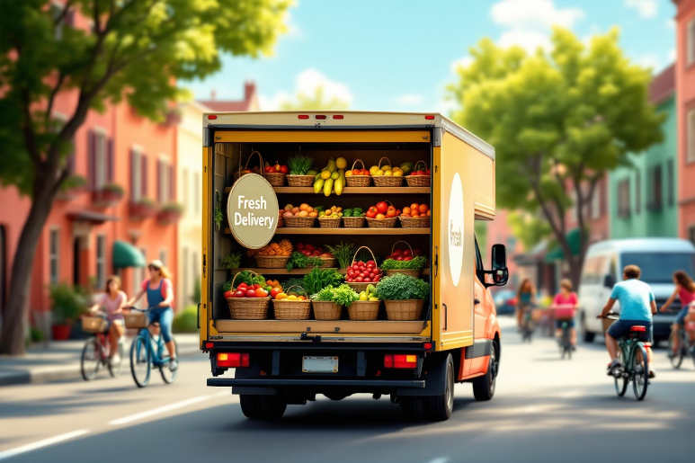
Case Study 2: Fresh Produce Delivery Optimization
Monitoring
Reduced waste, increased freshness.
Reduced transit times
Improved freshness, reduced waste.

Slide 15

Challenges in Cold Chain Implementation: Cost, Infrastructure
1
Initial investment
2
Infrastructure gaps
High upfront costs, technology integration.
Limited access to facilities, remote areas.
3
Maintenance
Ongoing maintenance and training costs.

Slide 16

Overcoming Challenges: Strategies for Effective Management
Strategic planning
Collaboration
Assess needs, phased implementation.
Partnerships, shared resources, training.
Innovation
Cost-effective technologies, automation.

Slide 17
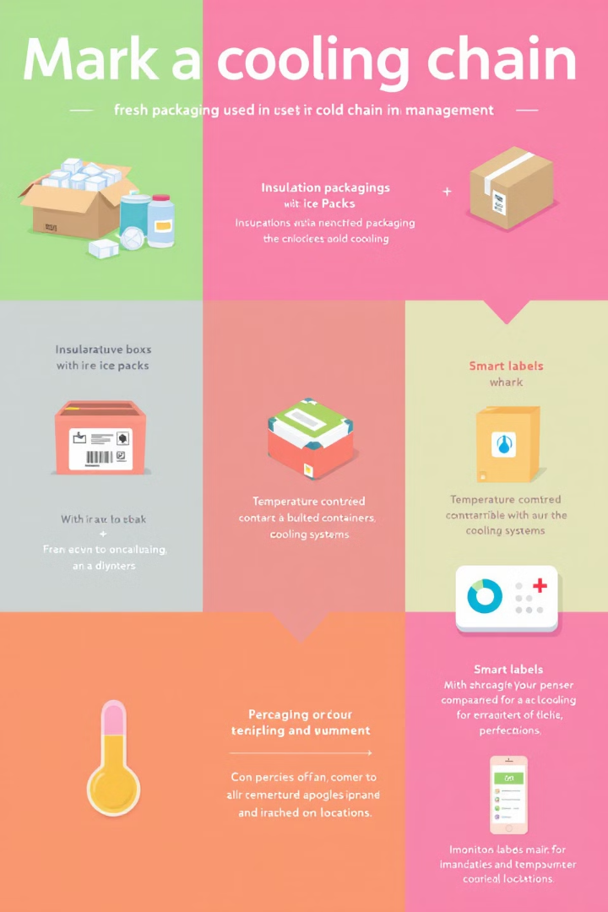



The Role of Packaging in Temperature Control
Protection
Insulation
Information
Shield goods, extends shelf life.
Maintains temperature, minimizes fluctuations.
Provides instructions, temperature history.

Slide 18
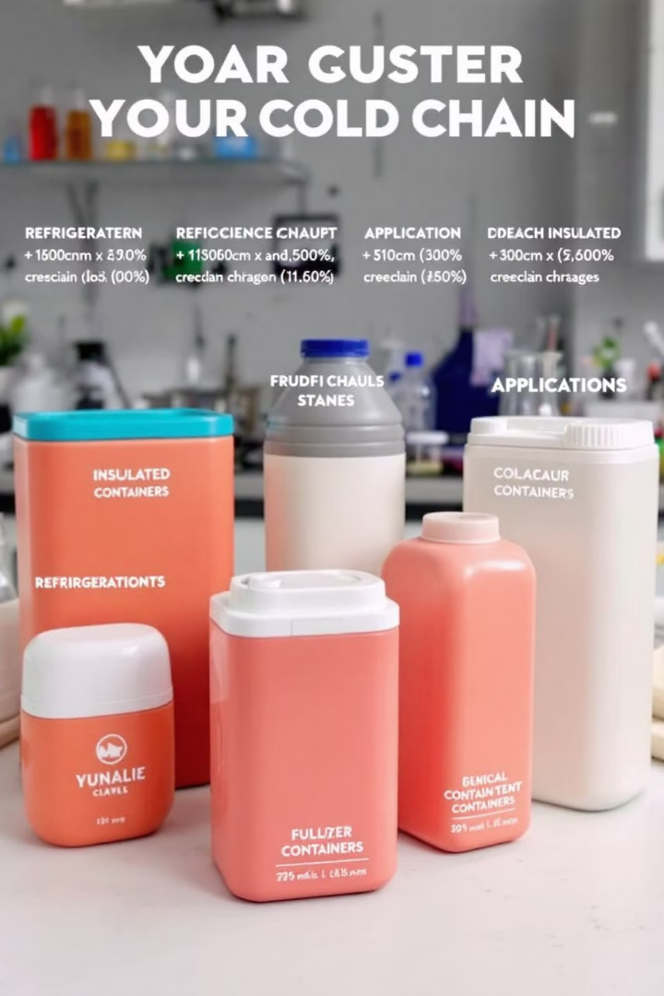
Insulated Containers and Refrigerants: Choosing the Right Solution
Containers
Vacuum Insulated Panels (VIPs).
Refrigerants
Dry ice, gel packs, phase-change materials.
Evaluation
Match the requirements.

Slide 19



Sustainable Cold Chain Practices: Reducing Environmental Impact
Packaging
2
Eco-friendly materials, recycling.
Energy
1
Efficient refrigeration, renewables.
Emissions
3
Lower carbon footprint.

Slide 20
The Future of Cold Chain: Innovations and Emerging Technologies
1
Automation
2
Digitalization
3
Connectivity

Slide 21
AI and Machine Learning in Cold Chain Optimization
1
Optimization
2
Prediction
3
Automation

Slide 22
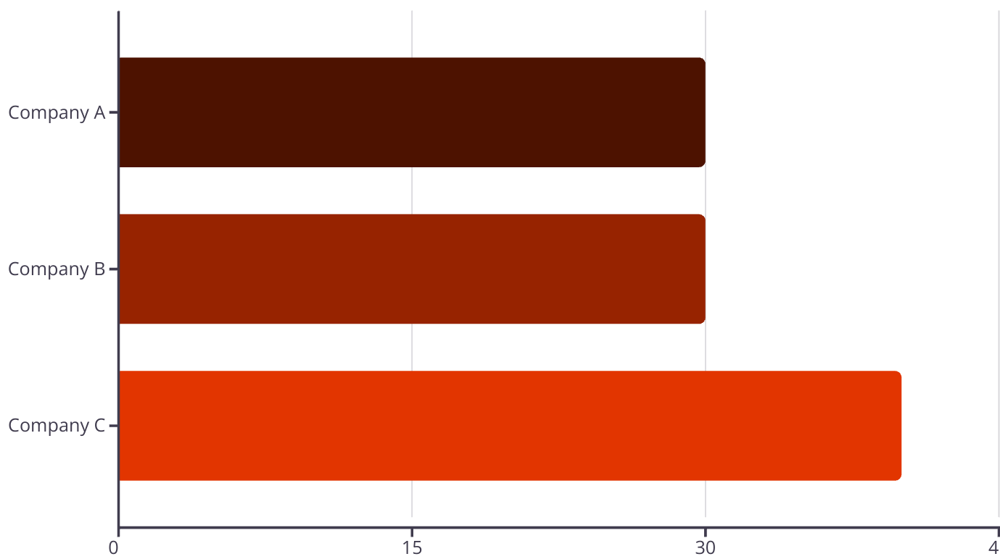
Blockchain for Enhanced Traceability and Transparency
Immutable record, end-to-end visibility, secure transactions.

Slide 23
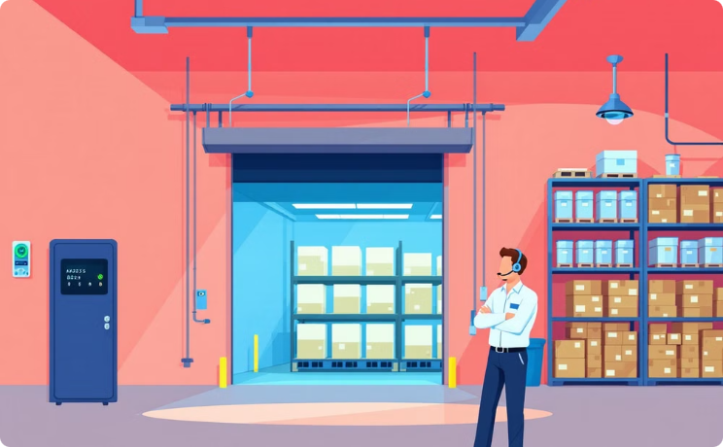
Cold Chain Security: Protecting Against Tampering and Theft
Monitoring
Tracking, intrusion detection.

Slide 24
Key Takeaways: Best Practices for Cold Chain Success
Monitoring
Compliance
Sustainability
Implement real-time temperature monitoring.
Adhere to regulatory standards, guidelines.
Adopt practices, reduce waste.

